Slide 1
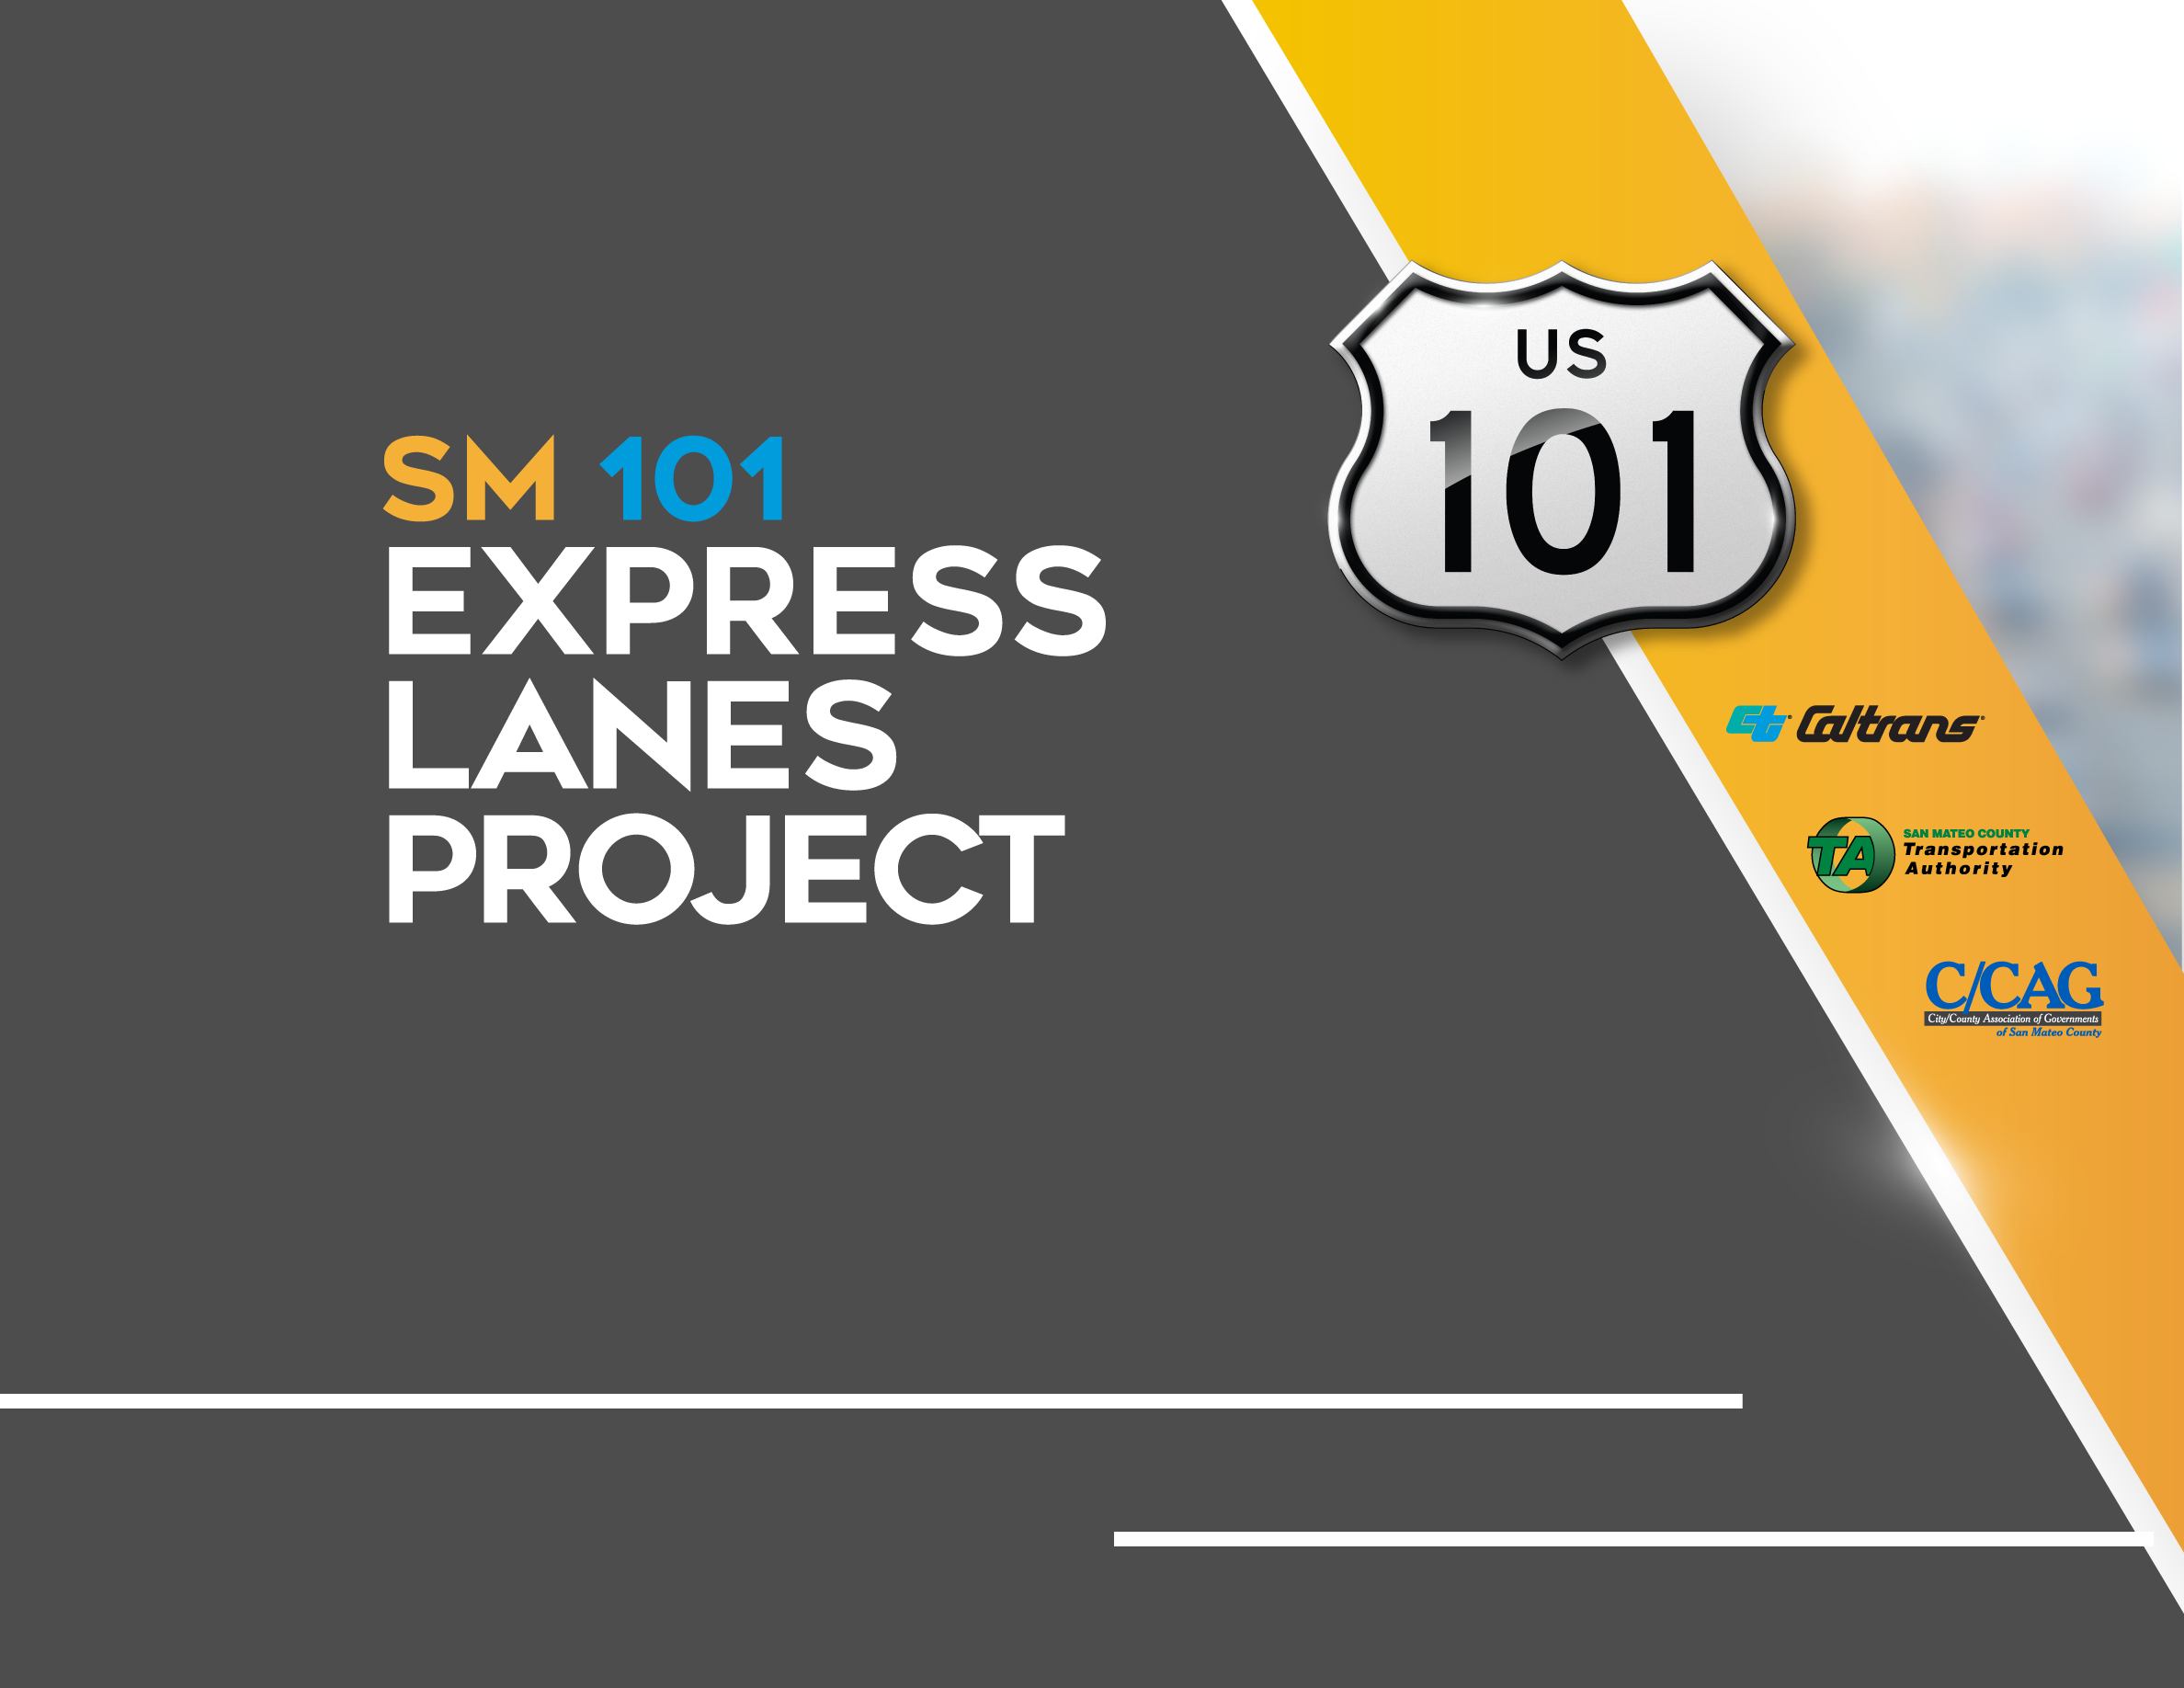
Quarterly Project Update
C/CAG Board of Directors Meeting February 9, 2023

Slide 2
AGENDA
  Project Progress
  Financial and Risk Status
  Communications Activities

Slide 3
  Project Progress
  Financial and Risk Status
  Communications Activities

Slide 4
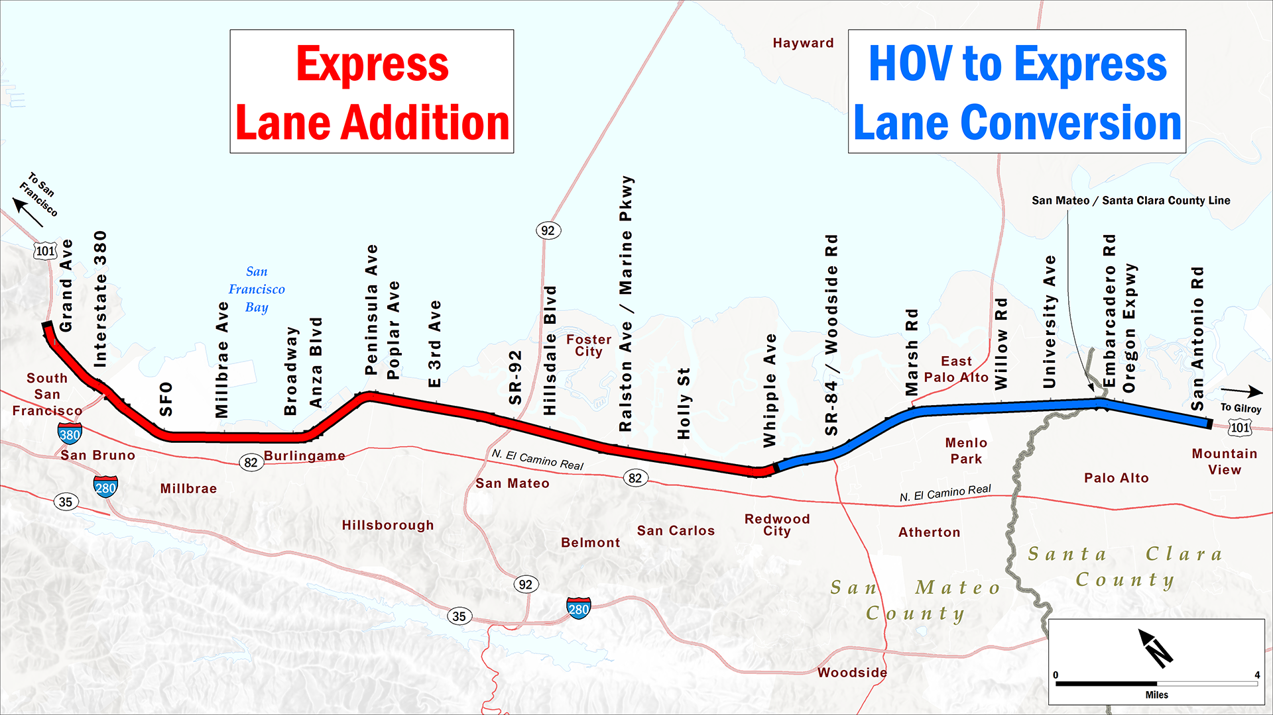
PROJECT LIMITS
Begin Tolling Soon
Operating Express Lanes
Notes:
The SM101 project includes building a new express lane on the northern half and converting the existing HOV lane in the southern half.

Slide 5
NORTH CONTRACT WORK COMPLETED
  Kiewit work north of Whipple Avenue through January 2023:
  Civil contract work 100% complete
  Proposed final cost: $350M out of $351.5M
  TransCore work north of Whipple Avenue through January 2023:
  Equipment installation, fiber splicing operation, and site commission testing 100% complete
  Most recent milestone cost (September): $20M out of $28.6M

Slide 6
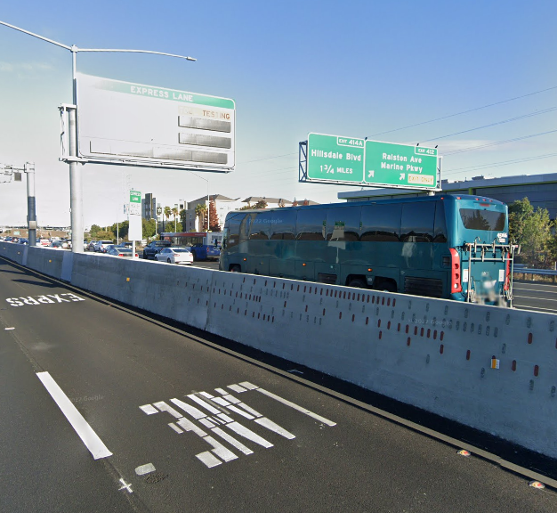
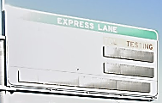
CURRENT OPERATIONS
EXPRESS LANE OPERATING IN HOV 3+ ONLY MODE

Slide 7
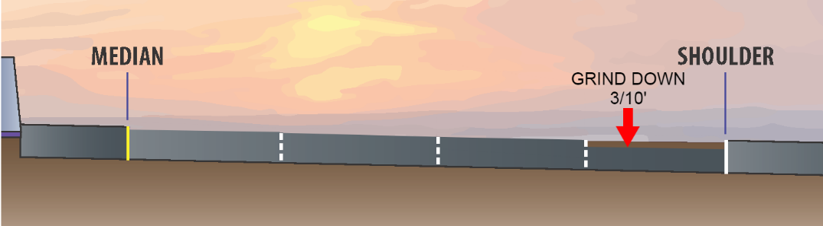
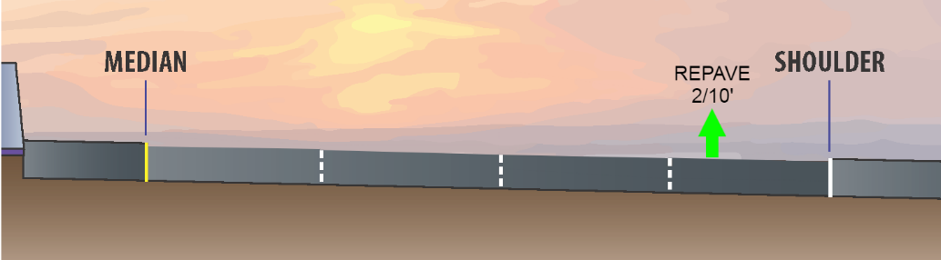
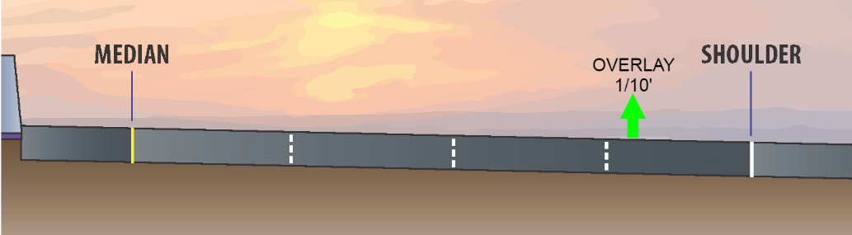
CONTRACT PAVEMENT WORK
North of Whipple Ave:
North of Broadway:
Step 1
Step 2
Step 1
Step 3
Notes:
Note that emergency repairs will attempt to fix structural section and that future projects currently programmed will repair pavement south of Broadway.

Slide 8
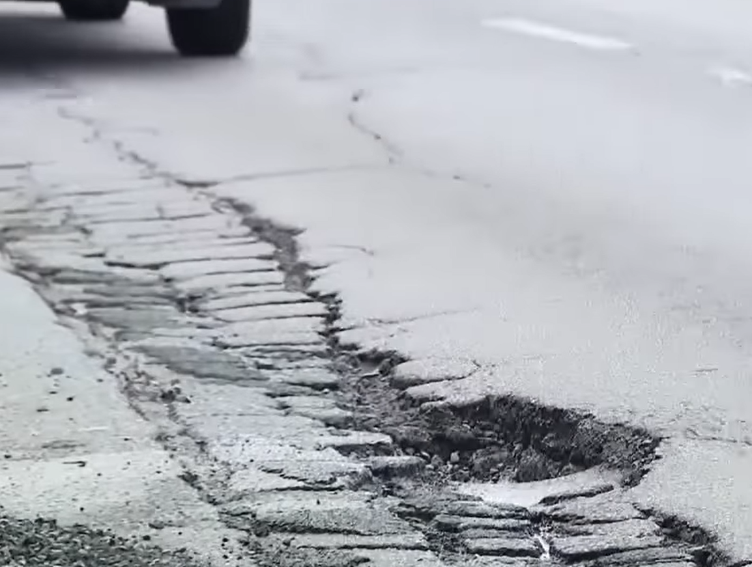

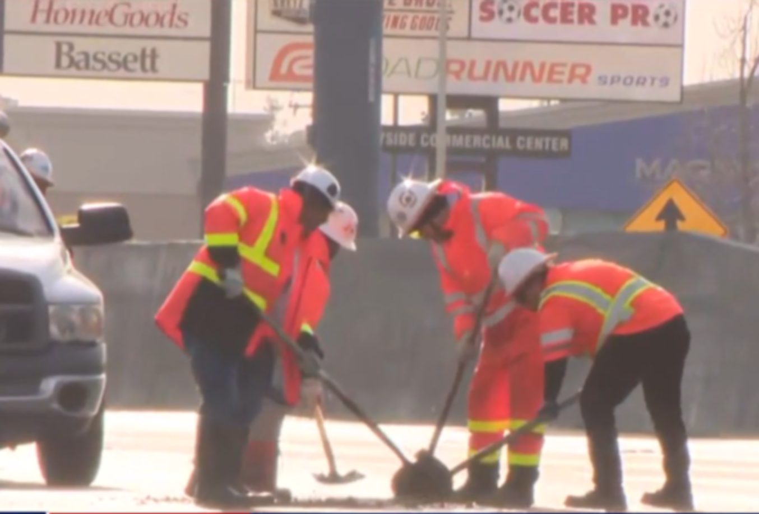
POTHOLE REPAIRS

Slide 9
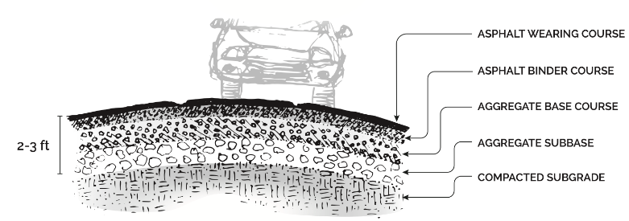
TYPICAL ROADWAY SECTION
Excessive rain has caused washout of the base, which causes potholes

Slide 10
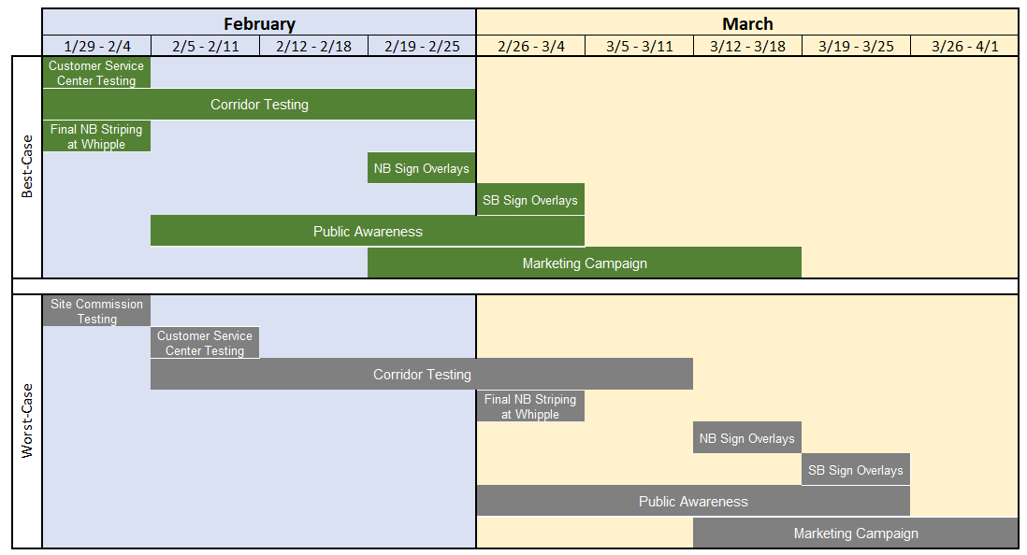
CURRENT END OF PROJECT SCHEDULE
*Schedule includes weather dependent activities and corridor testing uncertainty
Notes:
Other activities include closeout activities for Transcore, a toll commencement event, and the CTC vote to approve the highway planting funding.

Slide 11
  Project Progress
  Financial and Risk Status
  Communications Activities

Slide 12
CURRENT COST ESTIMATE - CONTRACT FOCUSED
(1) Estimated Cost represents current estimated cost to complete each contract.
(2) Expenditures exclude deposit against North Contract – Civil.
(3) Percent completes shown are based on qualitative assessment of physical % complete per milestones and schedule.
(4) Å = Within budget, Å = identified potential risks that may significantly exceed budget if not mitigated, Å = Known impacts to budget - changes forthcoming.

Slide 13
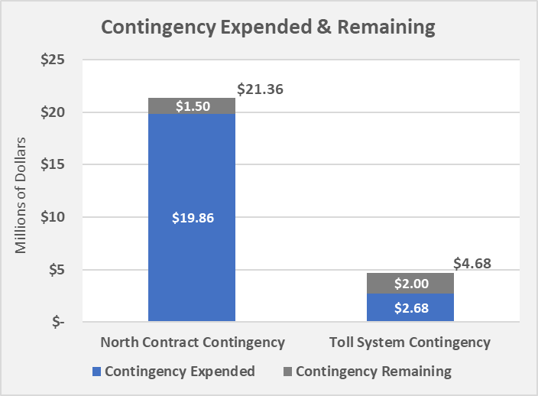
CONSTRUCTION CONTINGENCY BALANCES
Contract change orders for various reasons including, k-rail salvage, barrier foundation revisions, grade and drainage revisions, maintenance of landscape areas, signage issues, and pavement corrections.

Slide 14
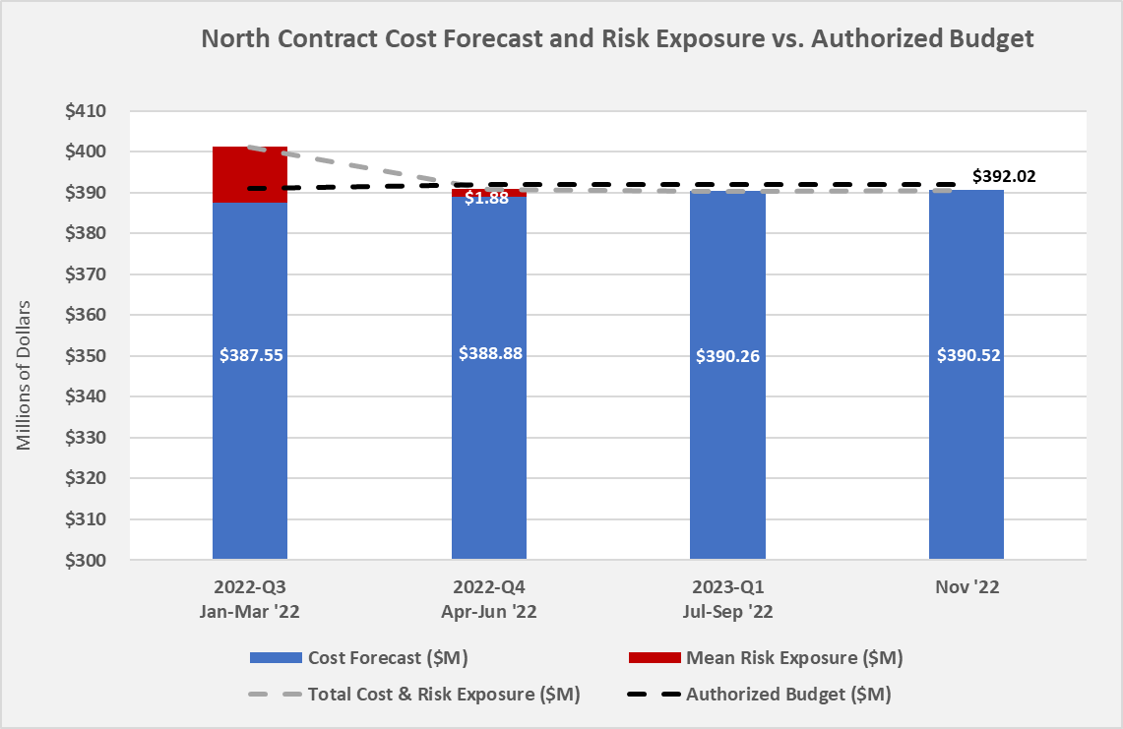

10.32
3.32

Slide 15
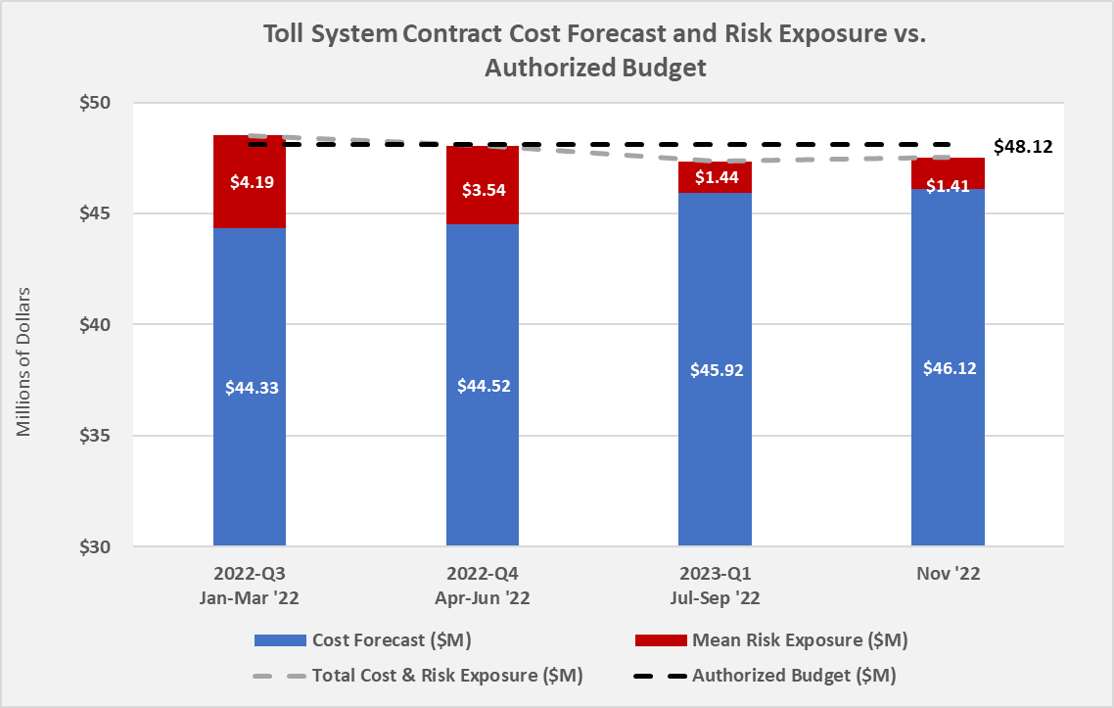

Slide 16
  Construction Progress
  Financial and Risk Status
  Communications Activities

Slide 17
START OF TOLLING OUTREACH
  Awareness Campaign – 4 weeks before tolling begins
    Earned Media: Press Release, News Communications
    Website and Social Media Messaging
    Communication to Commute.org/TDMs, CBOs and cities
  Advertising Campaign – 2 weeks before and after tolling begins
    Billboards along 101 corridor (digital)
    Terrestrial Radio (traffic, news, sports, entertainment)
    Gas Station Ads
    Multi-lingual media (Univision, News for Chinese)
Notes:
TDM – Transportation Demand Management Agencies, CBO – Community based organizations
This is the same information that Robert Casumbal presented to the SMCTA BOD on 1/13

Slide 18
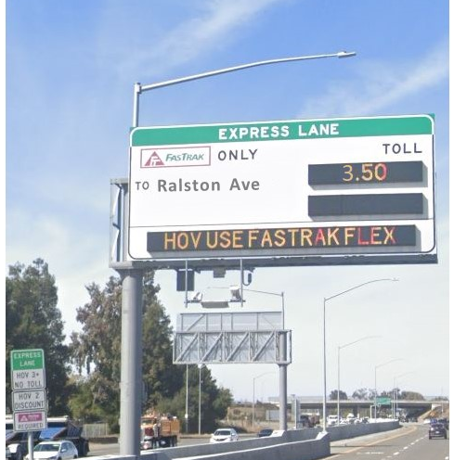
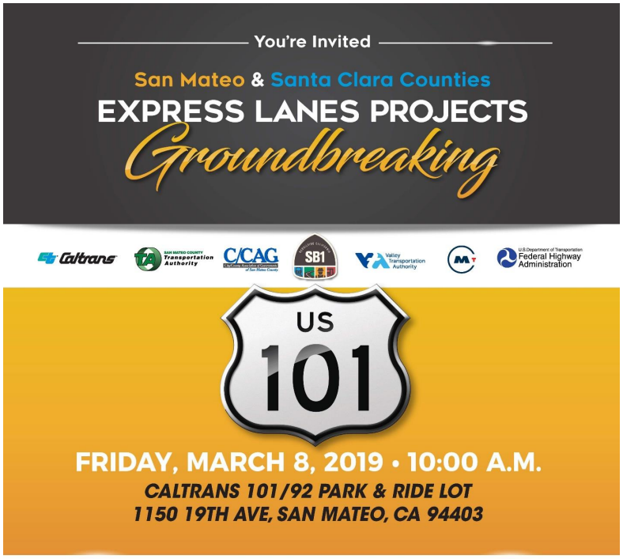
COMING SOON!
SAN MATEO - US 101 EXPRESS LANES PROJECT
Opening Event

Slide 19
Questions?

Slide 20
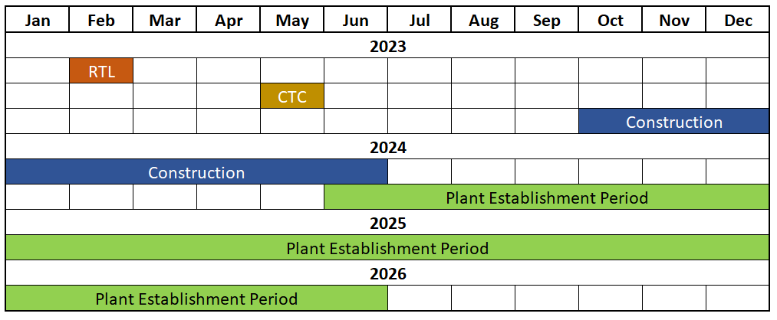


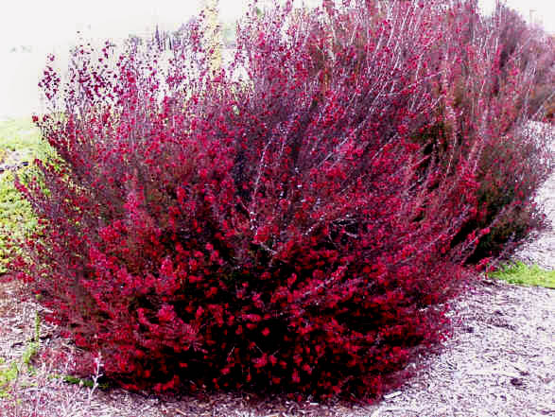

HIGHWAY PLANTING SCHEDULE
Notes:
Pictured Left to Right - Ray Hartman Wild Lilac, Dwarf Coyote Brush, New Zealand Tea Tree, Pride of Madeira

