Slide 1
Caltrans Project Updates to Congestion Management Program Technical Advisory Committee
April 17, 2025

Slide 2
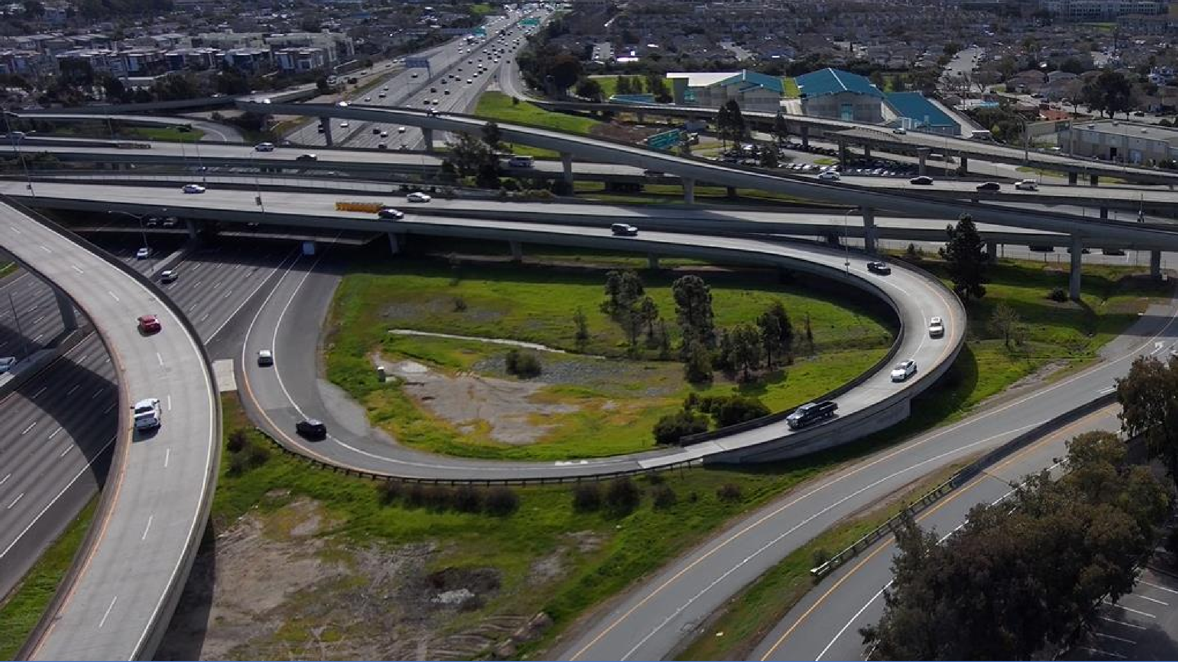
US 101/SR 92 Interchange Short-Term Area Improvements Project Update to Congestion Management Program Technical Advisory Committee
April 17, 2025

Slide 3
Presentation Outline
Project Overview
Design Features and Components
Public Information Efforts
Timeline

Slide 4
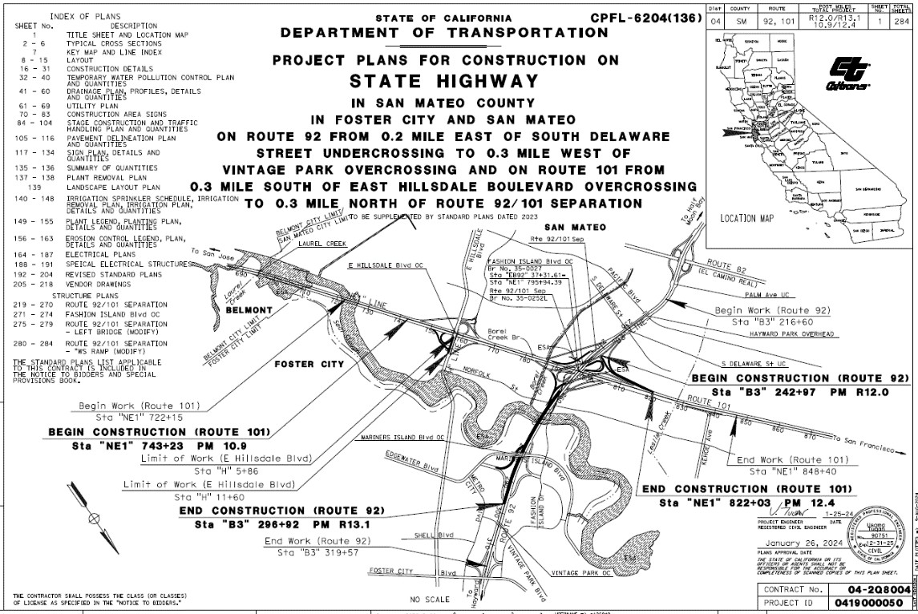
Project Location
In San Mateo County within Foster City and the city of San Mateo on SR 92 from east of South Delaware Street to Vintage Park and on US 101 from East Hillsdale Blvd to north of the US101/SR92 Interchange

Slide 5
Project Details
Contractor
Bid Amount
Working Days
Estimated Start
Estimated Comp
Gordon N. Ball, Inc.
$ 27,715,570.55
750d ( 500d Construction) Spring 2025
Summer 2028

Slide 6
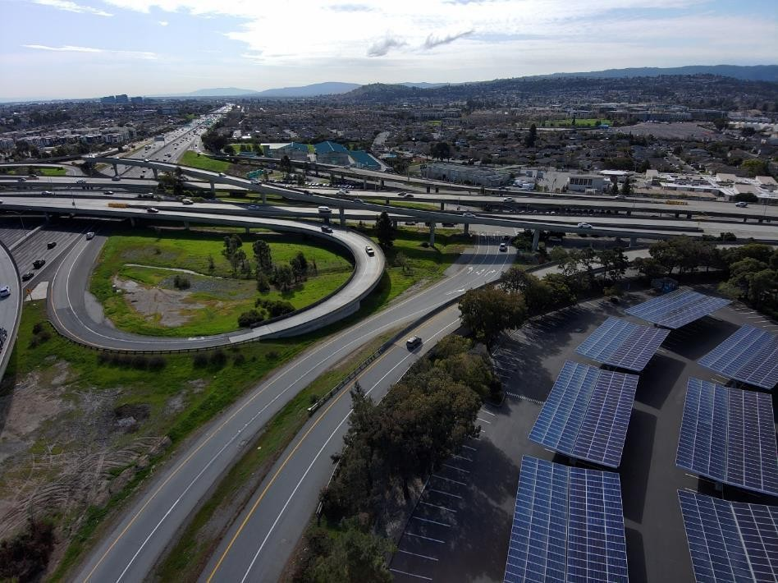
Sponsors
C/CAG
SMCTA
Implementing Agency
Caltrans
Stakeholders
City of San Mateo
City of Foster City
Contractor
Gordon N. Ball, Inc.

Slide 7
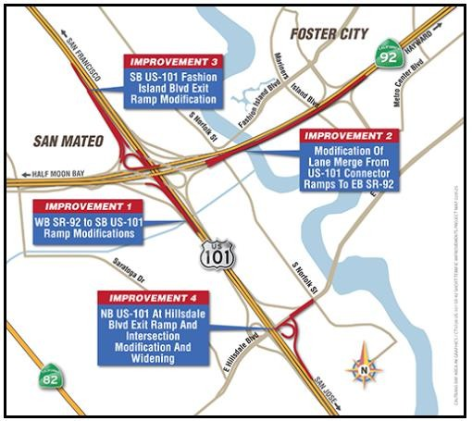
Project Scope
IMPROVEMENT 1 - Widening of WB 92- SB101 ramp structure
IMPROVEMENT 2 - Repaving and restriping of lanes on EB-92
IMPROVEMENT 3 - SB 101 Off-ramp
improvements
IMPROVEMENT 4 - Improvements at the NB101 offramp to Hillsdale Blvd

Slide 8
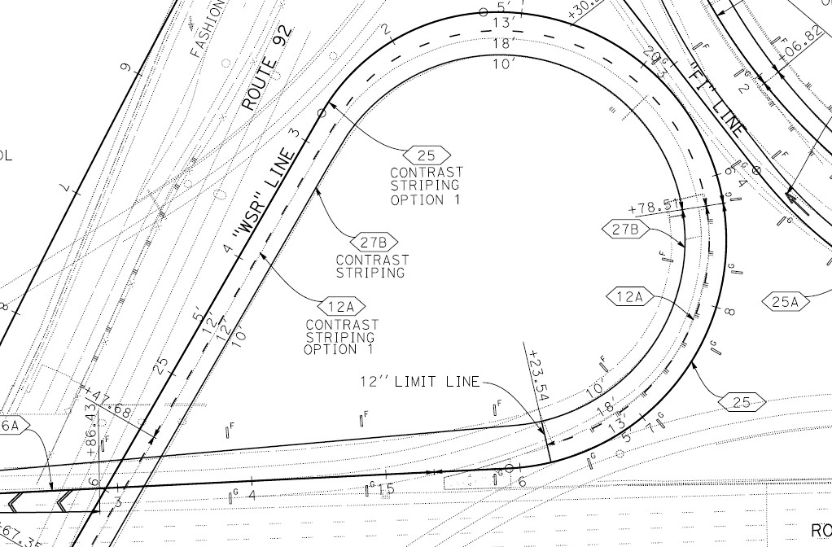
Improvement 1 – WB 92 to SB 101Ramp Modification
Widening of existing bridge ramp structure
Two lanes on ramp merging to one at US-101
Shoulder improvements on SM-101 to Fashion Island Blvd onramp

Slide 9
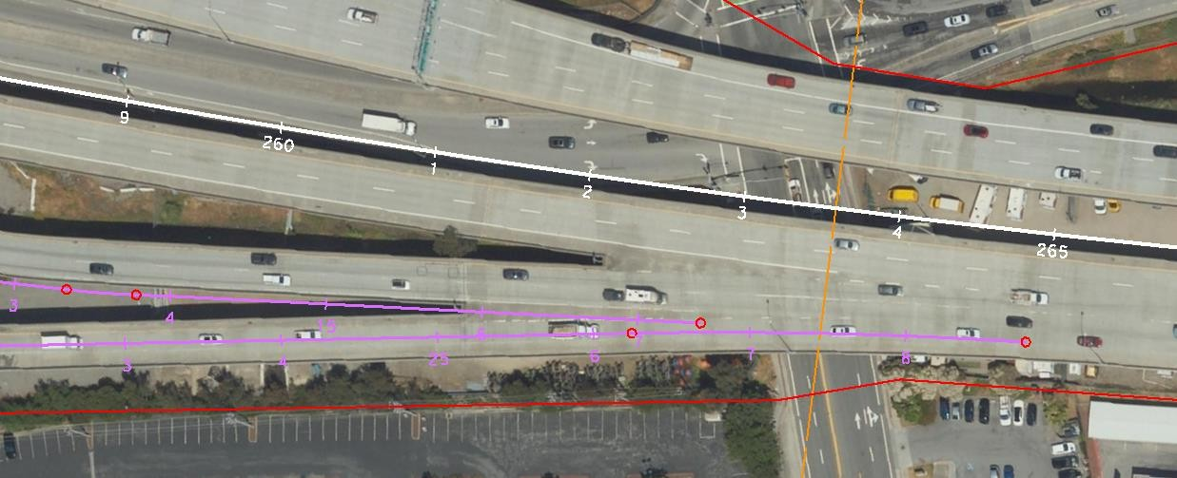
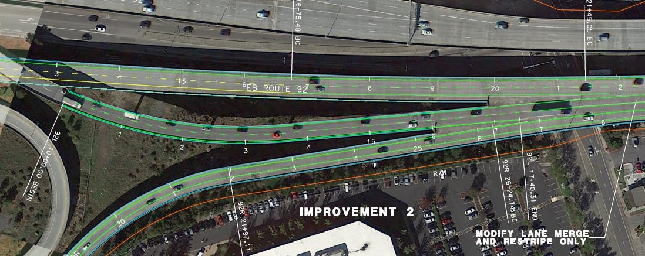
Improvement 2 – Modification of Lane Merge
Eliminating the merge between EB92 and SB101 connector ramps
Lengthening the merge
between SB101 connector and NB101 connector ramps
Ramp from NB 101
Before
After

Slide 10
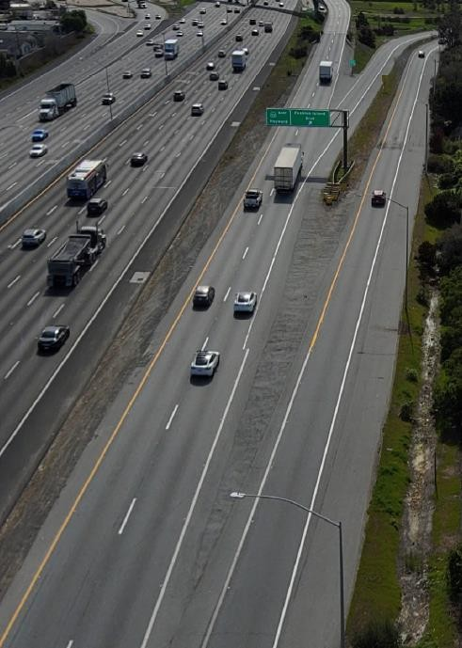
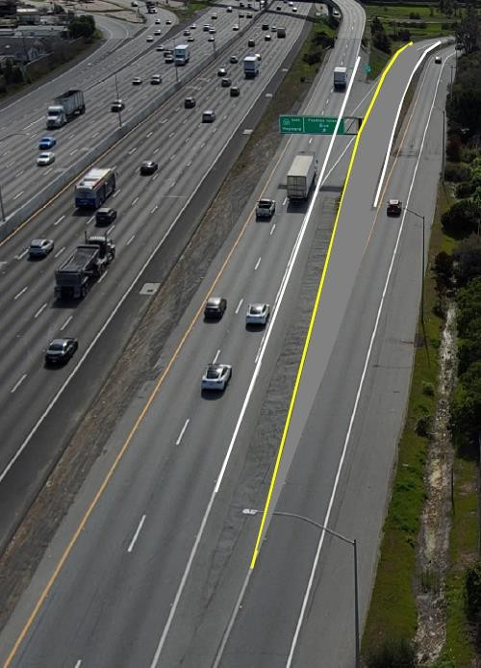
Improvement 3 – Modification of Lane Merge
Relocating the SB101 exit ramp for Fashion Island Blvd to split from the WB92 connector instead of the EB92 connector
Dedicated exit lanes to EB-92
Existing
Future

Slide 11
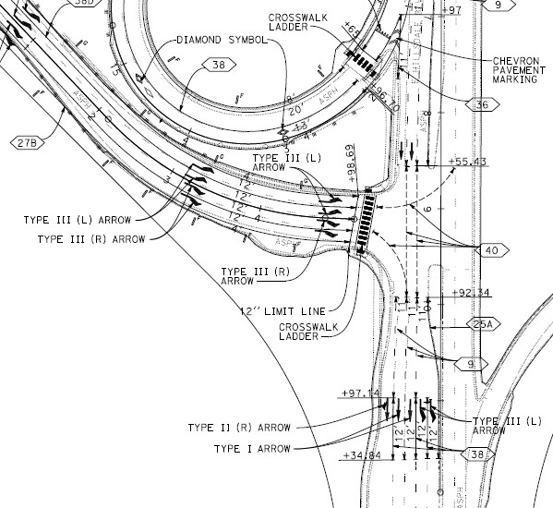
Improvement 4 – Modification at Hillsdale Blvd
Widening of the Hillsdale Boulevard exit ramp
Installing additional striping along Hillsdale Boulevard
Replacing crosswalk striping with ladder style stripes

Slide 12
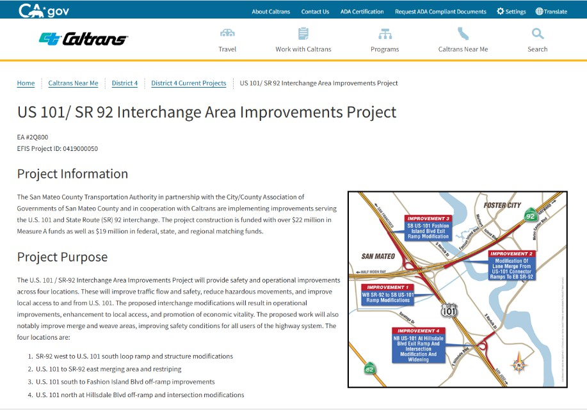
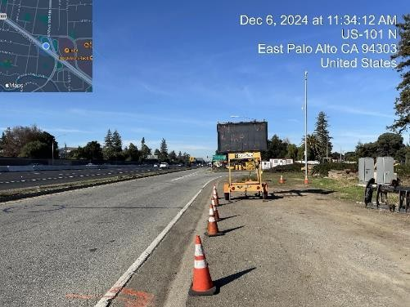
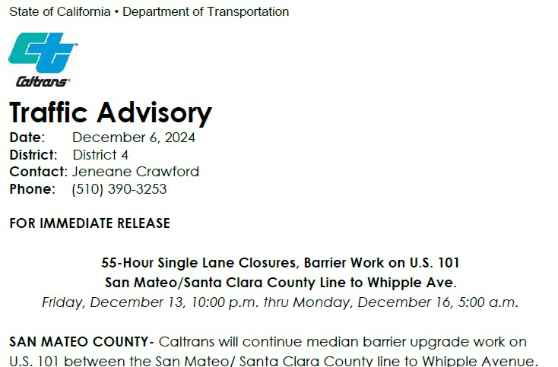
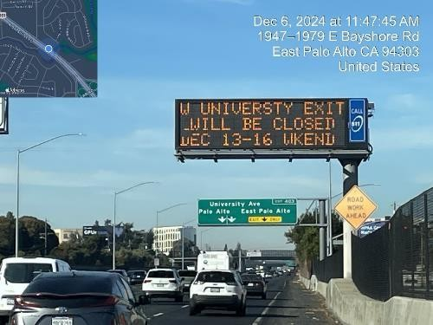
Outreach
PCMS Signs
Project Website
Traffic Advisories
Public Information Officer
Jeneane Crawford
(510) 390-3253
CMS Signs

Slide 13
Tentative Timeline
Estimated Start
Construction
Planting Period
Contract Completion
April 2025
Summer 2027
250 d
Summer 2028

Slide 14
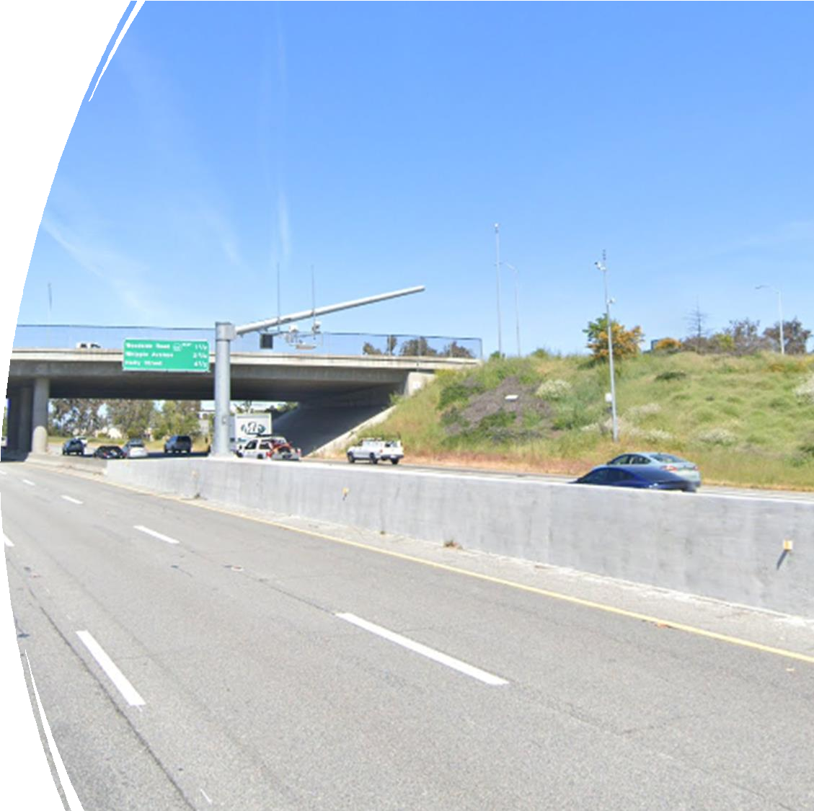
San Mateo County Project Highlight: US 101 Multi-Asset Capital Preventative Maintenance (CAPM) Project
Kelly Ma, Project Manager Contract 04-1Q582
04-SM 101-PM 0.0/21.8

Slide 15
Presentation Outline
Project Overview
Project Scope
Outreach Strategies
Questions

Slide 16
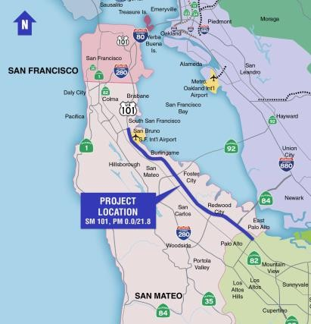
Project Location
In San Mateo County on US 101 in various cities, from Santa Clara/San Mateo County line to north of South Airport Boulevard

Slide 17
Project Details
State Highway Operation and Protection Program
(SHOPP Program) State Highway System’s “fix-it-first” program
SHOPP is based on performance-driven SHOPP10-year Project Book created entirely by the principles of asset management
Advertise
Award
Construction
Working Days
Construction Cap
Total Cost
Spring 2025
Summer 2025
Fall 2025 – Fall 2027
400 days
$ 143M
$ 178M

Slide 18
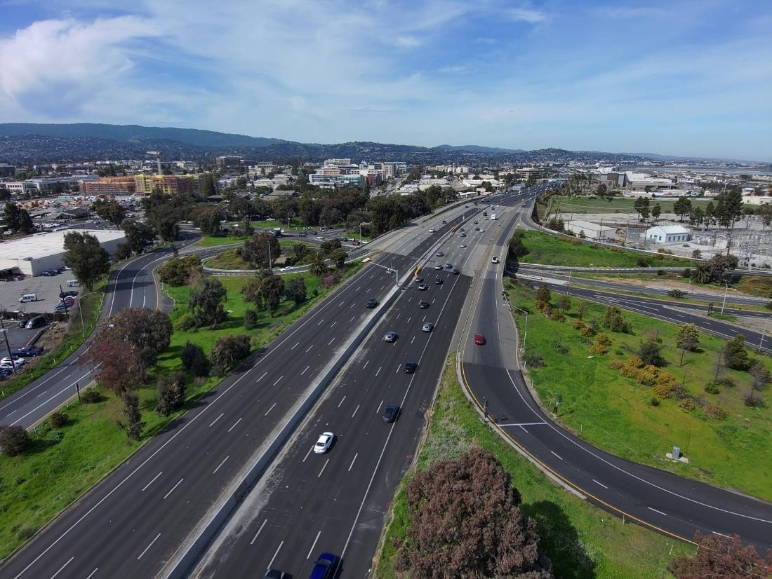
Project Scope
Rehabilitate pavement
Upgrade signage
Replace guardrail
Median barrier upgrade
Install trash capture devices
Improve Transportation Management System (TMS) elements
Rehabilitate drainage systems
Upgrade facilities to Americans with Disabilities Act (ADA) standards

Slide 19
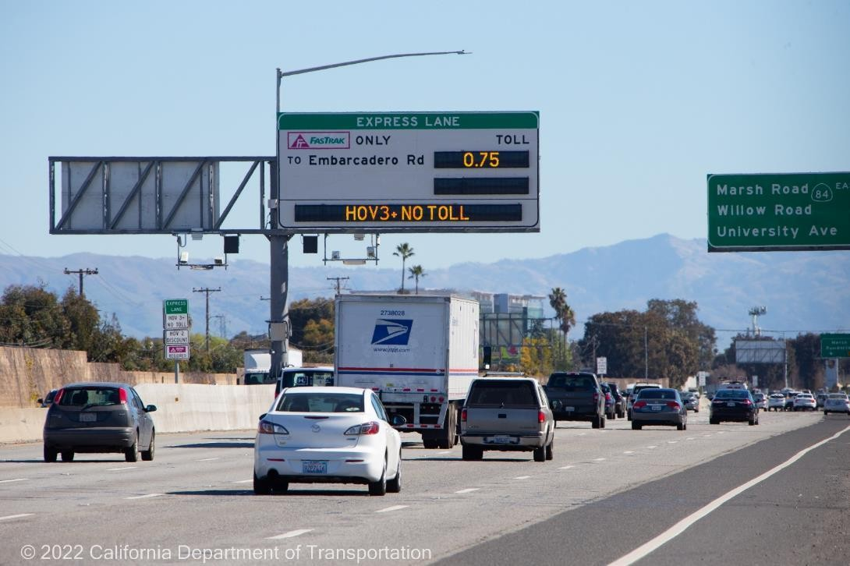
Additional Information
No impact to the express lanes, majority work is night work, express lane operation and revenue will not be impacted

Slide 20
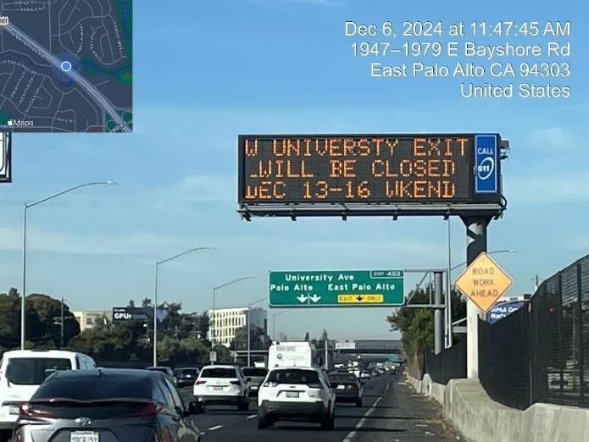
Outreach Strategies
PCMS Signs
Traffic Advisories
Public Information Officer Jeneane Crawford
(510) 390-3253
CMS Signs

Slide 21
Thank You • Questions ?

