Slide 1
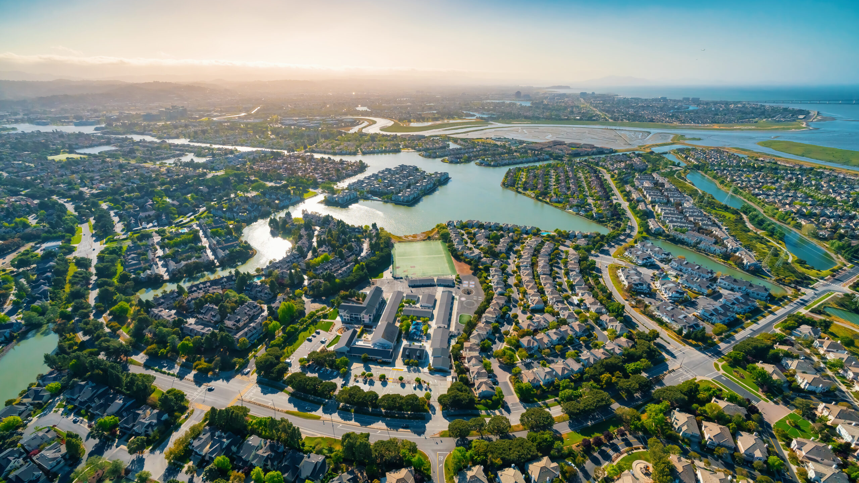


Stormwater Committee Presentations
C/CAG Stormwater Committee Meeting, March 20, 2025
Image Source: http://astanehelaw.com/2020/09/02/san-mateo-county-passes-emergency-ordinance-establishing-paid-sick-leave-for-the-coronavirus-covid-19-pandemic/

Slide 2
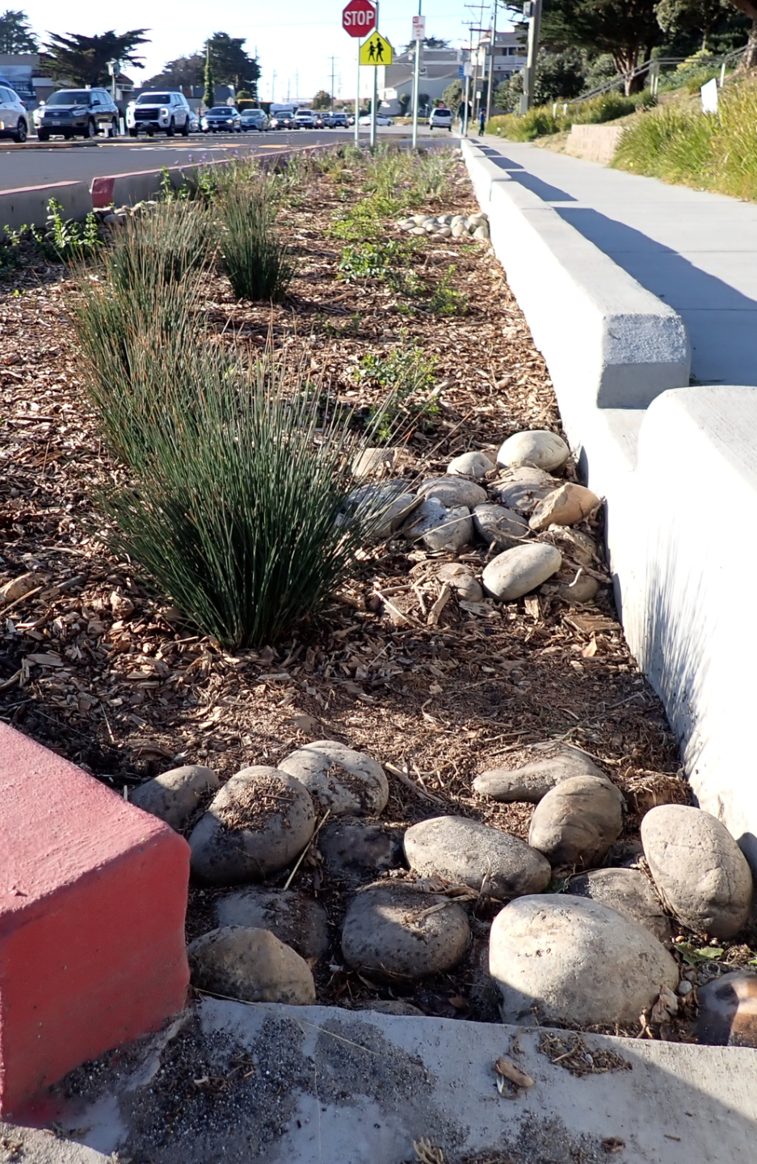
Item 1 – Call to Order/Roll Call/Hybrid Zoom Procedures

Slide 3
Item 2 – Public Comment (items not on the agenda)

Slide 4
Item 3 (PRESENTATION) – Receive a presentation from Save The Bay on the Flood Resilience Scorecard

Slide 5


Flood Resilience Scorecard
A tool for Completing Regional Shoreline Adaptation Plans
Laura Walsh, Policy Manager, Save the Bay

Slide 6
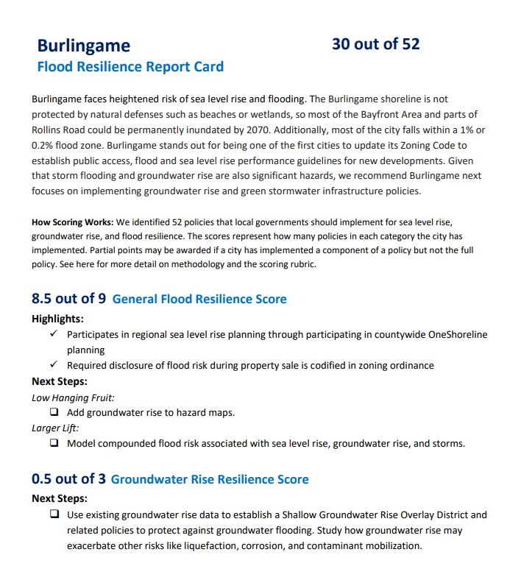
Why Did We Create These Scorecards?
Give cities a tool do complete their Regional Shoreline Plans
Highlight the good work that has been done and emphasize the work left on the road ahead
Meet the challenges of compound flooding and specific community concerns

Slide 7
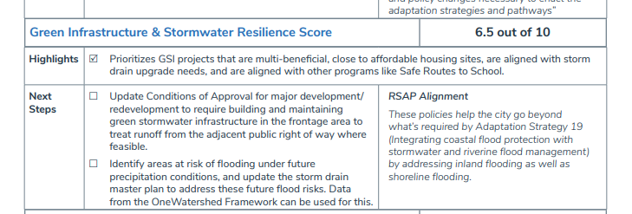
A Tool for Aligning with RSAP Planning

Slide 8
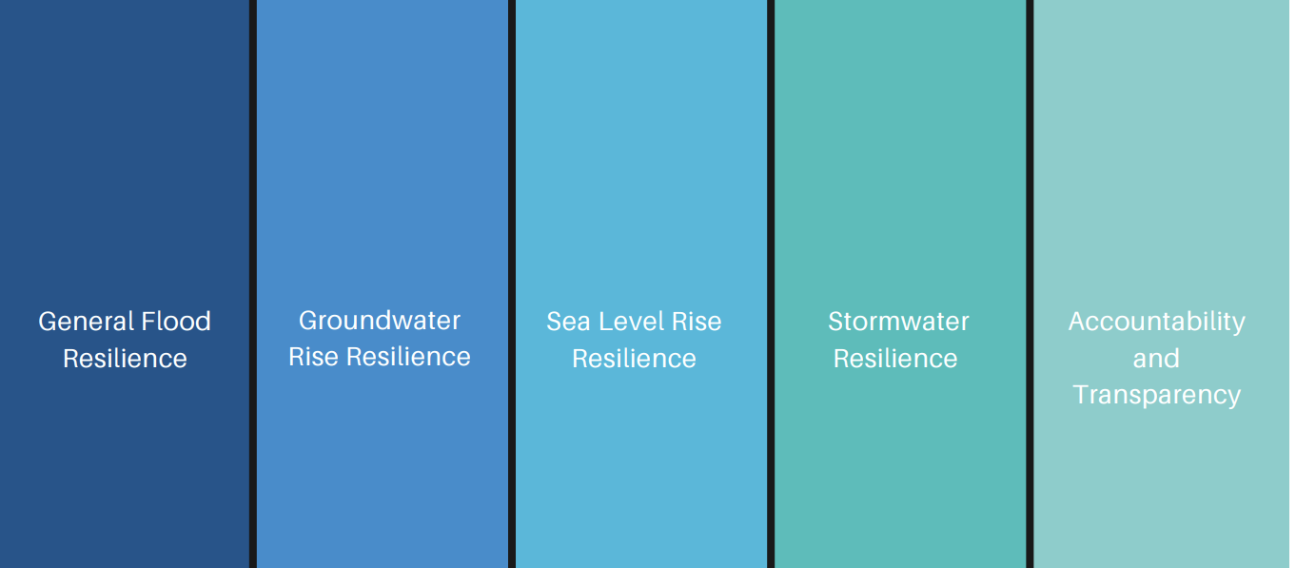
Snapshot of East Palo Alto Scorecard
Scores are added up for key policy areas. EPA’s score totals 26 out of 52
15 out of 29
.5 out of 3
2 out of 4
6.5 out of 10
2 out of 6

Slide 9

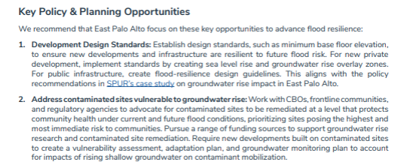
Top Recommendations from East Palo Alto Scorecard

Slide 10

Can you help us continue to apply this tool?
Let us know when/where it is useful to you
Suggest where/when we can integrate our recommendations as part of public processes
Bring decisionmakers on board

Slide 11




Leaning on the Scorecard
Can you consider nature-based projects a priority during the planning phase?
Can you consider how green stormwater infrastructure and shoreline planning are related and will require cross departmental collaboration?
Can you help us think about how to get some of these policies and projects earmarked and agendized?
Notes:
The policies draw on existing general plans, zoning policies, LHMPs, and climate adaptation plans of Bay Area cities; OneShoreline Sea Level Rise Planning Policy Guidance, BayAdapt Platform by BCDC, and Greenbelt Alliance's Resilience Playbook

Slide 12

Thank You lwalsh@savesfbay.org

Slide 13
Item 4 (ACTION) –
Review and approve February 20, 2025 Stormwater Committee minutes

Slide 14
Item 5 (ACTION) –
Review and approve recommendation for C/CAG’s Duly Authorized Representative to certify and submit the SMCWPPP Water Year 2024 Urban Creeks Monitoring Report to the Regional Water Board

Slide 15

Urban Creeks Monitoring Report
Provision C.8.h.iii of the MRP requires that permittees submit a UCMR at the countywide level by March 31 of each year
The UCMR includes reporting on all wq data collected during prior Water Year (October 1, 2023-September 30, 2024)
On behalf of the San Mateo County permittees, SMCWPPP develops and submits the UCMR to the San Francisco Bay Regional Water Board
On February 17, C/CAG staff distributed the Draft UCMR to the Watershed Assessment and Monitoring (WAM) Subcommittee for review and the main components of the Draft UCMR were presented to the WAM on March 6
Final revised UCMR was distributed to the Committee on March 14 and will approval of the staff recommendation will be submitted to the Regional Water Board by March 31

Slide 16
Item 6 (INFORMATION) – Receive a presentation on upcoming deadline for 100% trash reduction requirements

Slide 17
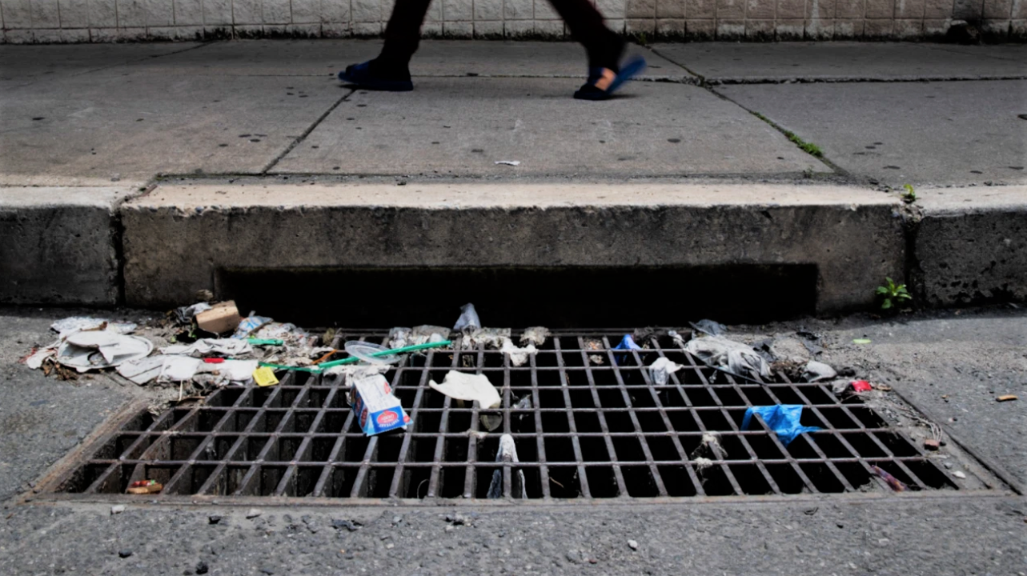
MRP Stormwater Trash Reduction Update
SMCWPPP Stormwater Subcommittee
March 20, 2025
Chris Sommers
EOA, Inc.

Slide 18
MRP Provision C.10 Requirements
C.10.a - Trash Reduction
Implement trash load reduction control actions (i.e., full trash capture systems or equivalent measures) to meet the goal of 100 percent trash load reduction by June 30, 2025.
C.10.g.viii - Reporting
If unable to attain 100 percent trash load reduction by June 30, 2025, submit a notice of noncompliance and a plan to come into compliance with the 100 percent trash load reduction requirement.
C.10.a.ii.(b) – Private Land Drainage Areas
By July 1, 2025, ensure that private lands that are moderate, high, or very high trash generating, and that drain to storm drain inlets that Permittees do not own or operate (private), but that are plumbed to Permittees’ storm drain systems are equipped with full trash capture systems or are managed with trash discharge control actions equivalent to or better than full trash capture systems.

Slide 19
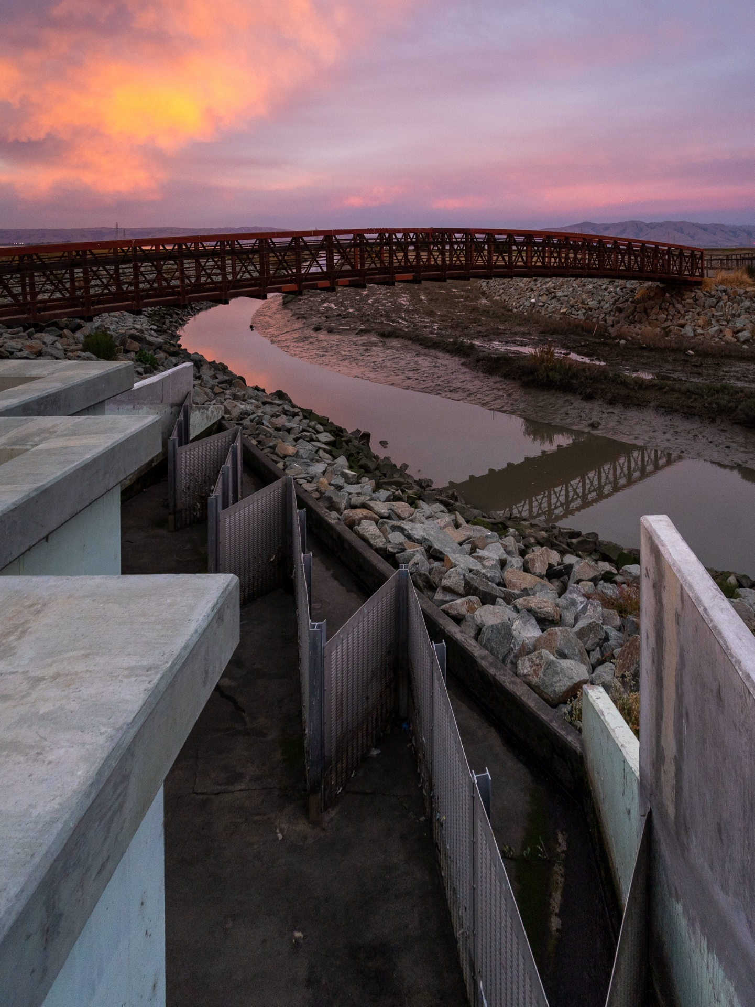
C.10.a - Trash Reduction
Assistance from SMCWPPP
Evaluation of Control Measure Options
Siting of Full Trash Capture Devices
Conducting On-land Visual Trash Assessments (OVTAs)
Data Management and Reporting Assistance
  GIS data
  OVTA data
  Trash Reduction Calculations
  Annual Reporting
Additional Guidance
Through FY 23/24 – 90% collective trash reduction (all SMCWPPP member agencies combined)
East Palo Alto Full Trash Capture System

Slide 20
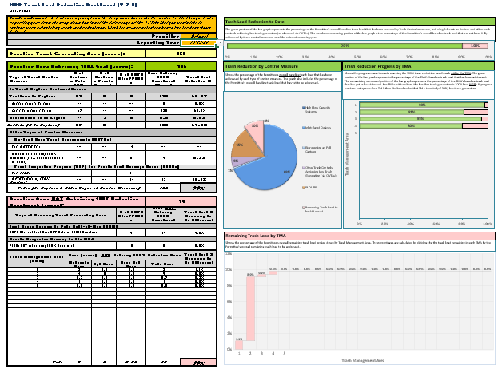
C.10.g.viii – Reporting (June 30, 2025)
Assistance from SMCWPPP
Development of Trash Load Reduction Procedure and Annual Calculations
Model Notice of Non-compliance Letter
Model Updated Trash Load Reduction Plan

Slide 21
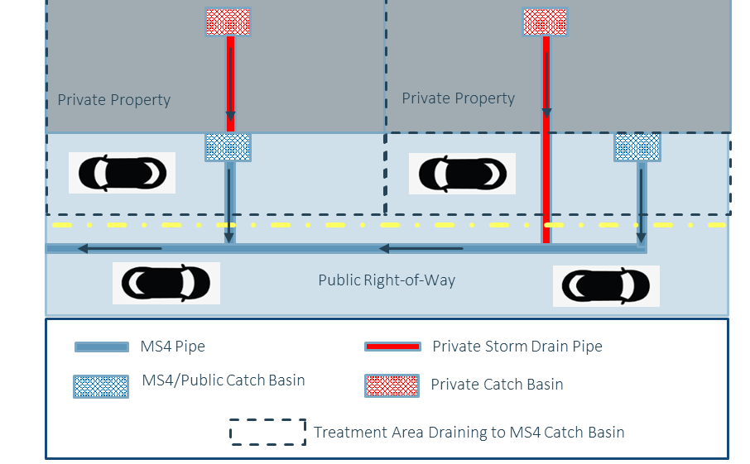
C.10.a.ii.(b) – Private Land Drainage Areas (PLDAs)
Assistance from SMCWPPP
Identification of PLDA Properties
Model PLDA Inspection Program and Field Forms
Implementation Guidance
PLDA Inspector Training
PLDA Inspection Data Management

Slide 22
Key Member Agency Submittals and Dates
June 30, 2025
  If your city/county/town cannot demonstrate achievement of the 100% trash reduction benchmark, submit a Notice of Non-compliance Letter and Model Updated Trash Load Reduction Plan to the Water Board
  All member agencies need to complete PLDA inspections by June 30, 2025
September 30, 205
  Submit FY 24/25 annual report to Water Board, including an updated trash reduction estimate

Slide 23
SMCWPPP Assistance Timeline
Late March: Distribute Model Notice of Non-compliance Letter and Model Updated Trash Load Reduction Plan Template to SMCWPPP Member Agencies
March – May: Receive and Process from SMCWPPP Member Agencies:
  New Full Trash Capture system data
  PLDA Inspection Data
March – Early May: Complete Remaining On-land Visual Trash Assessments (OVTAs)
May – June: Calculate Preliminary Trash Reductions for each SMCWPPP Member Agency
March – June: Provide as-needed additional guidance on trash management, compliance determinations, and reporting
July – Aug: Develop updated trash reduction estimates for FY 24/25 Annual Reports

Slide 24

Questions
Chris Sommers
EOA, Inc.
csommers@eoainc.com

Slide 25
Item 7 (INFORMATION) –Receive information on upcoming stormwater cost reporting requirements and timelines

Slide 26


Update on Stormwater Permit
Cost Reporting Requirements and Deliverables
C/CAG Stormwater Committee
March 20, 2025
Jill Bicknell, P.E., EOA

Slide 27
C.20 Cost Reporting Requirements
Provision C.20 requires Permittees to annually prepare/submit a fiscal analysis of the costs to implement the MRP, beginning in FY 2024/25 (first submittal is due with the September 2025 Annual Report).
The costs must be reported by permit provision and in defined categories such as personnel, contractors, capital costs and O&M.
In addition, the State Water Board has adopted a State Cost Reporting Policy that would apply to all municipal Permittees in the State, beginning in FY 2026/27 (work is beginning to align the two reporting requirements).

Slide 28
C.20 Cost Reporting Tools and Guidance
Collaborated with other countywide programs through BAMSC to complete a Bay Area Cost Reporting Framework (Excel-based tool) and Guidance Manual (March 2024).
Developed a SMCWPPP-specific version of the tool (with countywide program costs for FY 2024/25)
Conducted a training for SMCWPPP member agencies on July 24, 2024.
Currently providing on-call support for SMCWPPP member agencies as cost reports are prepared

Slide 29
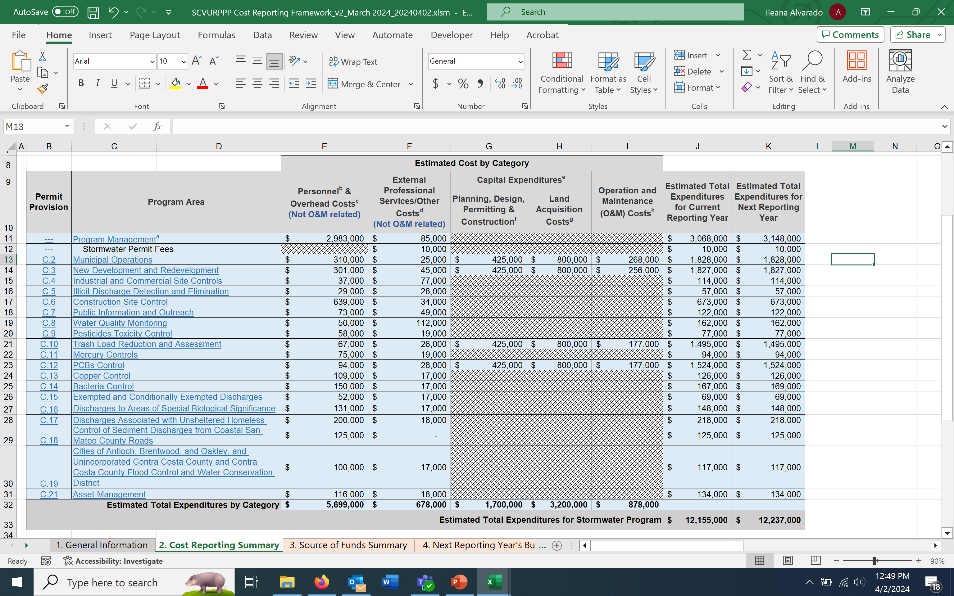
Example Cost Reporting Summary Table

Slide 30
Bay Area Cost Reporting Guidance Manual
Background
Approach
General Guidance and Assumptions
Organization and Use of Framework
Guidance by MRP Provision
Estimating Costs for the Upcoming Fiscal Year
Reporting Sources of Funds
App A – Cost Reporting Cover Sheet

Slide 31
Challenges with Cost Reporting
Working with various municipal departments to estimate their costs related to the stormwater program
  Determining how to best represent personnel and overhead costs, e.g., by FTE or actual costs, and how to represent different staff classifications
Allocating costs across the different MRP provisions
Estimating capital and O&M costs for publicly owned stormwater quality related assets (e.g, green infrastructure (GI) and trash full capture systems)

Slide 32
Annual Cost Reporting Process
Permittees will submit their cost reports for FY 2024/25 on September 30, 2025, as part of FY 2024-25 Annual Reports
What to include in Annual Report:
  Cover sheet (see Appendix A of Guidance Manual for example)
  Cost Reporting Summary Table (PDF)
  Source of Funds Summary Table (PDF)
Annual Reports are submitted in SMARTS (publicly available)
**Water Board staff may request submittal of the entire spreadsheet if needed**

Slide 33
Questions?

Slide 34
Item 8 (INFORMATION) – Receive stormwater program related information and announcements

Slide 35
Stormwater Program Announcements
C/CAG Board updates: February – Approved Resolution 25-06 amending the Congestion Management Program Technical Advisory Committee Guidelines and the Stormwater Committee guidelines; received a presentation on the San Mateo County OneWatershed Climate Resilience Framework and Community-Led Plan.
CASQA 2025 Call for Abstracts and upcoming Seminar Series
  April 7 at noon – call for abstracts due
  April 17 – Seminar Series/Funding
Annual Reports: On March 3, Regional Water Board staff distributed a memo to all MRP countywide program managers outlining staff review of the Fiscal Year 2023-24 Annual Reports
  Additionally, the BAMSC co-chairs submitted the Fiscal Year 2024-25 Annual Report Forms to the Regional Water Board on Mar 3 as required by the MRP – final forms will be distributed once approved

Slide 36
Stormwater Program Announcements
SF Bay Regional Water Quality Control Board Triennial Review
  Comments on Triennial Review Staff Report and Prioritized Projects List due Mar 31 (SMCWPPP not planning to submit comments)
The Funding & Finance Ad-hoc Workgroup met on March 7 and received a presentation from Craftwater Engineering on potential strategies and phases of developing a stormwater funding initiative
  Will continue to meet in coming months to determine near term strategy
C/CAG staff is developing the FY 2025-26 Preliminary Draft Budget for SMCWPPP (will coordinate with the MRP Ad-hoc Workgroup and present the initial draft budget at the April Committee meeting)

Slide 37
Stormwater Program Announcements
City and County of San Francisco v. Environmental Protection Agency
  SCOTUS ruled Clean Water Act under section 1311(b)(1)(C) does not authorize the EPA to include "end-result" receiving water limitations provisions in NPDES permits – receiving water limits have been in all NPDES permits to-date
  Key issue - WQ limitations actually imposed by the EPA or states vs. limitations that direct permittees to achieve an “end result” in a receiving water
  Emphasizes the importance of NPDES permits as a protective shield against citizen suits under the Clean Water Act (argues end result requirements for compliance with permits are not protective as intended)
  Decision applies to all NPDES permits, but there is different statutory language for MS4 permits (section 1342(P)(3))
    Industrial Discharge Permits must comport with 1311/1342 while MS4 permits are regulated separately under 1342

Slide 38
Stormwater Program Announcements
  Under 1342(P)(3) EPA/state have discretion to allow for receiving water limitations in MS4 permits
  Porter-Cologne Act in CA provides additional discretion (covers state discharge and federal NPDES requirements)
  Impact on future permits - effluent based limitation requirements/more monitoring
  Less exposure to citizen suits for receiving water limitations under Clean Water Act/greater exposure for effluent based limitations or receiving water limitations at the state level
  Ongoing coordination via CASQA – will be a town hall event (TBD)
  May result in a memo/communication from State Water Board to Regional Water Boards (all NPDES permit reissuances on-hold)

Slide 39
Item 9 – Regional Water Board Report

Slide 40
Item 10 – Executive Director’s Report

Slide 41
Item 11 – Member Reports

Slide 42
Item 12 – Adjourn

