Slide 1
August 20, 2026
C/CAG CMP TAC

Slide 2
01
CTP Process & Update
Agenda
02
Vision, Goals & Framework
03
Draft Project List
04
Draft Initiatives
05
Next Steps

Slide 3
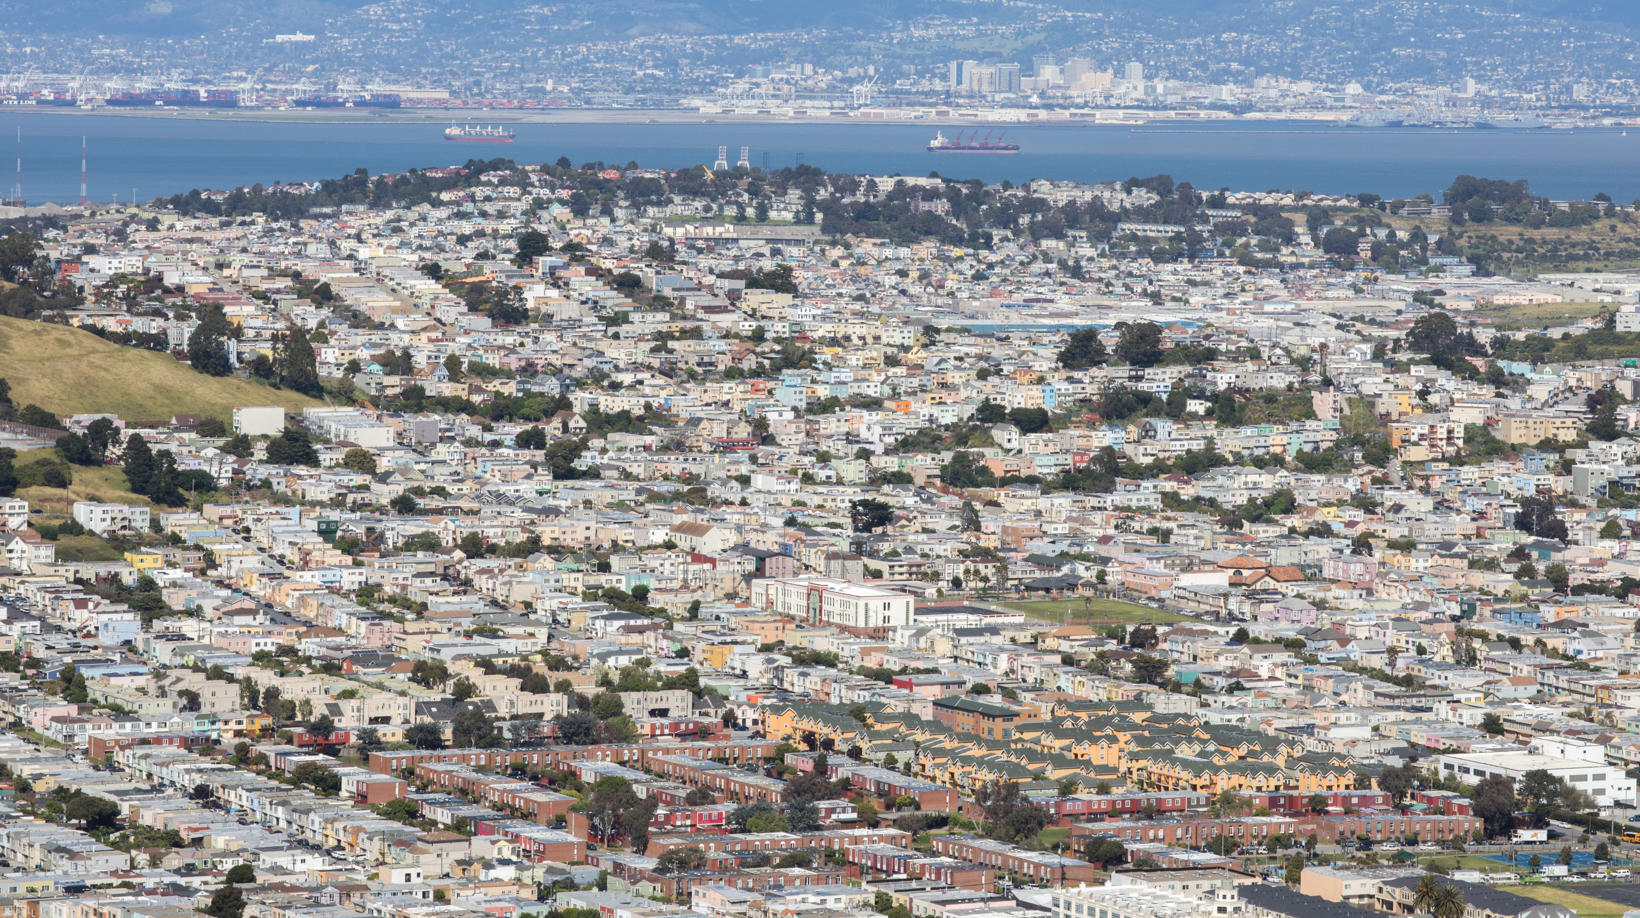
SECTION 01
CTP PROCESS & UPDATE

Slide 4


Purpose of CTP
Create a vision for the future of transportation in San Mateo County.
Set C/CAG and SMCTA priorities, and guide decision-making.
Inform planning, funding, and delivery of local and regional transportation improvements.
Notes:
The CTP helps San Mateo County align our vision with the Metropolitan Transportation Commission (MTC's) Regional Transportation Plan. C/CAG.
C/CAG: owner of the CTP, strategic coordination, policy development, and liaison to RTP
TA: funding and delivery strategy for countywide programs and projects
The Countywide Transportation Plan (CTP) creates a vision for the future of transportation in San Mateo County, sets priorities, and guides decision-making at the City/County Association of Governments of San Mateo county (C/CAG) and the San Mateo County Transportation Authority (SMCTA) as they plan, fund, and help deliver local and regional transportation improvements.

Slide 5
CTP Process
Winter 2025/6
Spring 2026
Summer/ Fall 2026
Winter 2026/7
Spring 2027
Define Vision and Goals for CTP Update
Develop Policy Framework
Generate Draft Project and Program List
- Review with Cities
Draft
Plan
Final
Plan
Engagement Touchpoints
Notes:
Engagement touch points are illustrated in orange

Slide 6
Round 1 Outreach Efforts
30
15
6
1
Roadshow presentations to city transportation and countywide committees
Prior countywide outreach efforts reviewed for relevance to the CTP
CBO Interviews
Continuously accessible website
We sought input
To validate existing travel trends observed in the data
On transportation needs and challenges
On community transportation priorities for the next decade
On Draft CTP Goals
Notes:
Example outreach efforts we reviewed include:
Reimagine SamTrans
Commute.org’s Countywide Commuter Survey
Regional Transit Connections Plan
North, Mid, and South County Multimodal Strategies
Community-Based Transportation Plans
CBO interviews: One interview was held in each of the North, Central, South, and Coastal subregions, with an additional interview in both the North and Coastal areas to address gaps in prior engagement

Slide 7
What We Heard from Community Members
Need… Safety & Comfort Improvements
AVs & E-Bikes
…More Frequent Transit
Senior Mobility
…support for School Trips
…Highway 1 & El Camino Real Improvements
Successful Caltrain Electrification!
…more Caltrain/BART Connections
…to close Network Gaps
…Better Coastal Access
…More Attention to Non-Work Trips
Text size reflects the number of input sources (Committees, CBO Interviews, Plan & Data Review) in which the theme was raised

Slide 8
Today we are looking for feedback on…
Vision and Goals: do these resonate with you?
Project List: are these the right local projects?
Initiatives: does this mix of initiatives address your key transportation concerns between now and 2050?
What’s missing: anything you’re not seeing in this update that you think the CTP should address?
Notes:
Are these the right projects to be considered?

Slide 9
SECTION 02
VISION, GOALS, & FRAMEWORK

Slide 10
CTP Vision
The San Mateo CTP envisions a county where residents, workers, and visitors can travel safely, reliably, and with convenient choices across all modes. People easily connect to daily needs via streets, trails, transit service, and highways that are resilient and endure for generations.

Slide 11
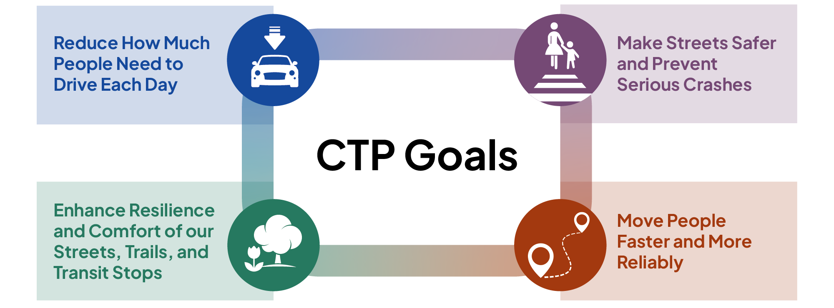
CTP Goals
Notes:
We will measure progress on these goals by tracking metrics like
Daily miles driven per capita
Fatal and severe injury crashes
Pavement condition on roads and trails, and
Travel times on major roads and bus lines

Slide 12
How will the CTP help you align for funding?
Equity Focus Area Definition: a countywide spatial equity definition updated to incorporate the latest census data and add a first and second tier for greater county coverage.
Focus Geographies & Strategies: where are improvements most urgently needed in the county (e.g., flood zones, high injury network, etc.) and what strategies do we have to address those needs?
Place Type Design Expectations: context-sensitive design guidance that aligns with state and regional best practice on target speeds, sidewalk widths, bicycle facility type, and more.
Notes:
Our goals only get delivered through actual projects, so achieving the goals depends on local projects lining up with the CTP.
Alignment is how a local project connects to the plan: it shows the project is addressing the needs the CTP has identified
The CTP gives you two things to align to: the focus geographies and strategies (where the needs are and what to do about them), and the place-type design expectations (what good design looks like in that context).
When a local project aligns with these, it's positioned for funding success, both through our programs and when we go after outside regional and state grants.
The next few slides walk through how that alignment works in practice, starting with the focus geographies and strategies.
We’ve developed a few tools to help jurisdictions and agencies identify and implement projects that align with the CTP Vision and Goals:
Will be integrated into future funding calls; likely to show up in future CFPs, consider place types and geographies. Provide documentation for exception

Slide 13
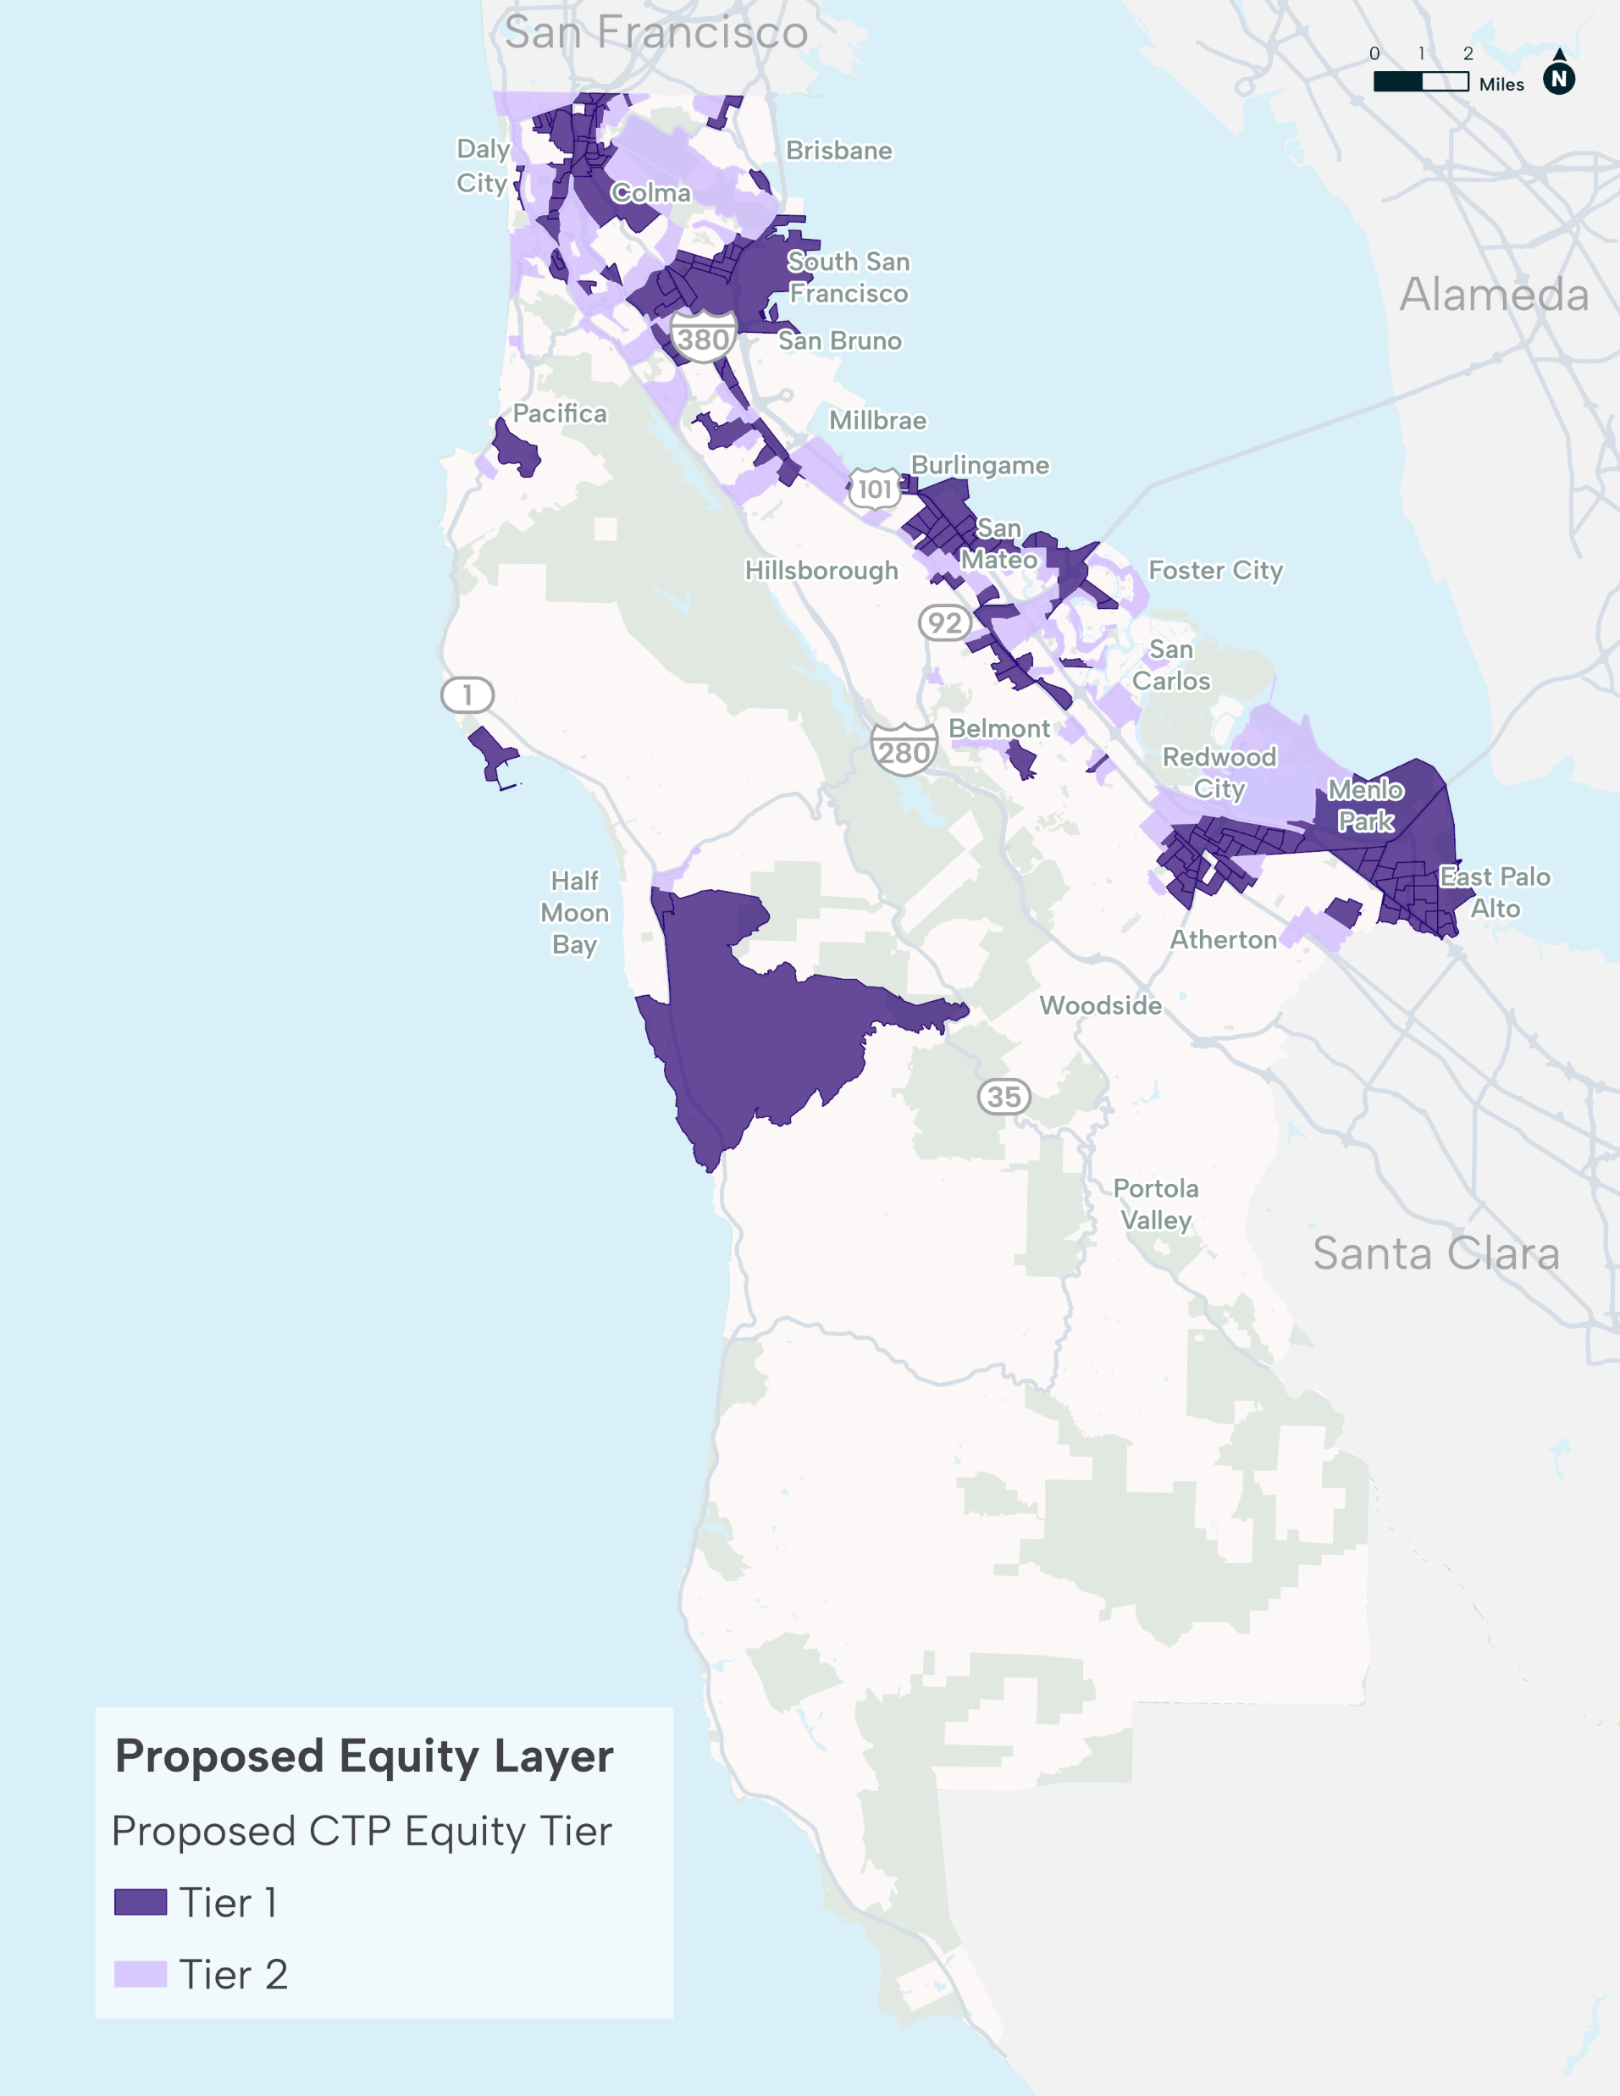
New Equity Definition for Funding Decisions
map
Simplified definition based on income, race, vehicle ownership, and rental cost burden
By introducing tiers, we now consider more of the county in equity-based planning and funding decisions (49% of households covered, up from 21%)
Notes:
Equity presented in March to the TAC

Slide 14
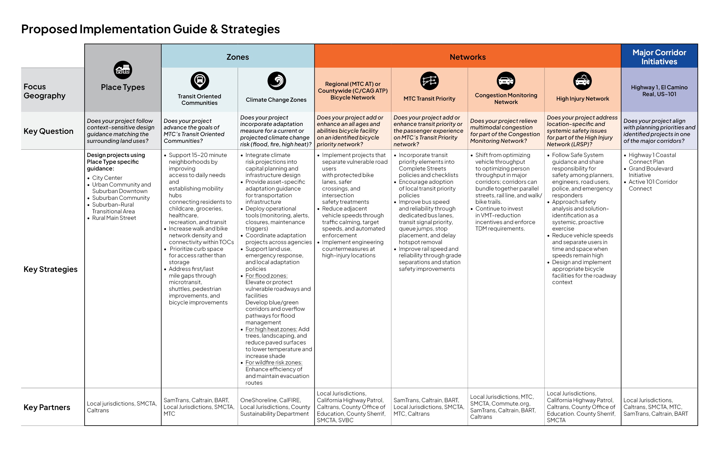
Focus Geographies & Strategies
Notes:
For Committees only
So, how do we turn these goals into action?
The Implementation Guide connects the County's existing focus geographies—identified through other planning and policy efforts like the Transit-Oriented Communities Program and Congestion Monitoring Network—to recommended project strategies. This gives agencies a practical starting point when developing projects and helps ensure each investment advances the County's goals while identifying opportunities to deliver multiple benefits.
Click – Animation
For each focus geography, the guide outlines key questions agencies should ask during project development, highlights recommended strategies, and identifies the partners who should be involved throughout the process.
Click – Animation
We'll walk through one example today. Using Place Types, the guide links transportation solutions to the surrounding land use and context, illustrating how agencies can use the framework to develop more complete, context-sensitive, and impactful projects.

Slide 15
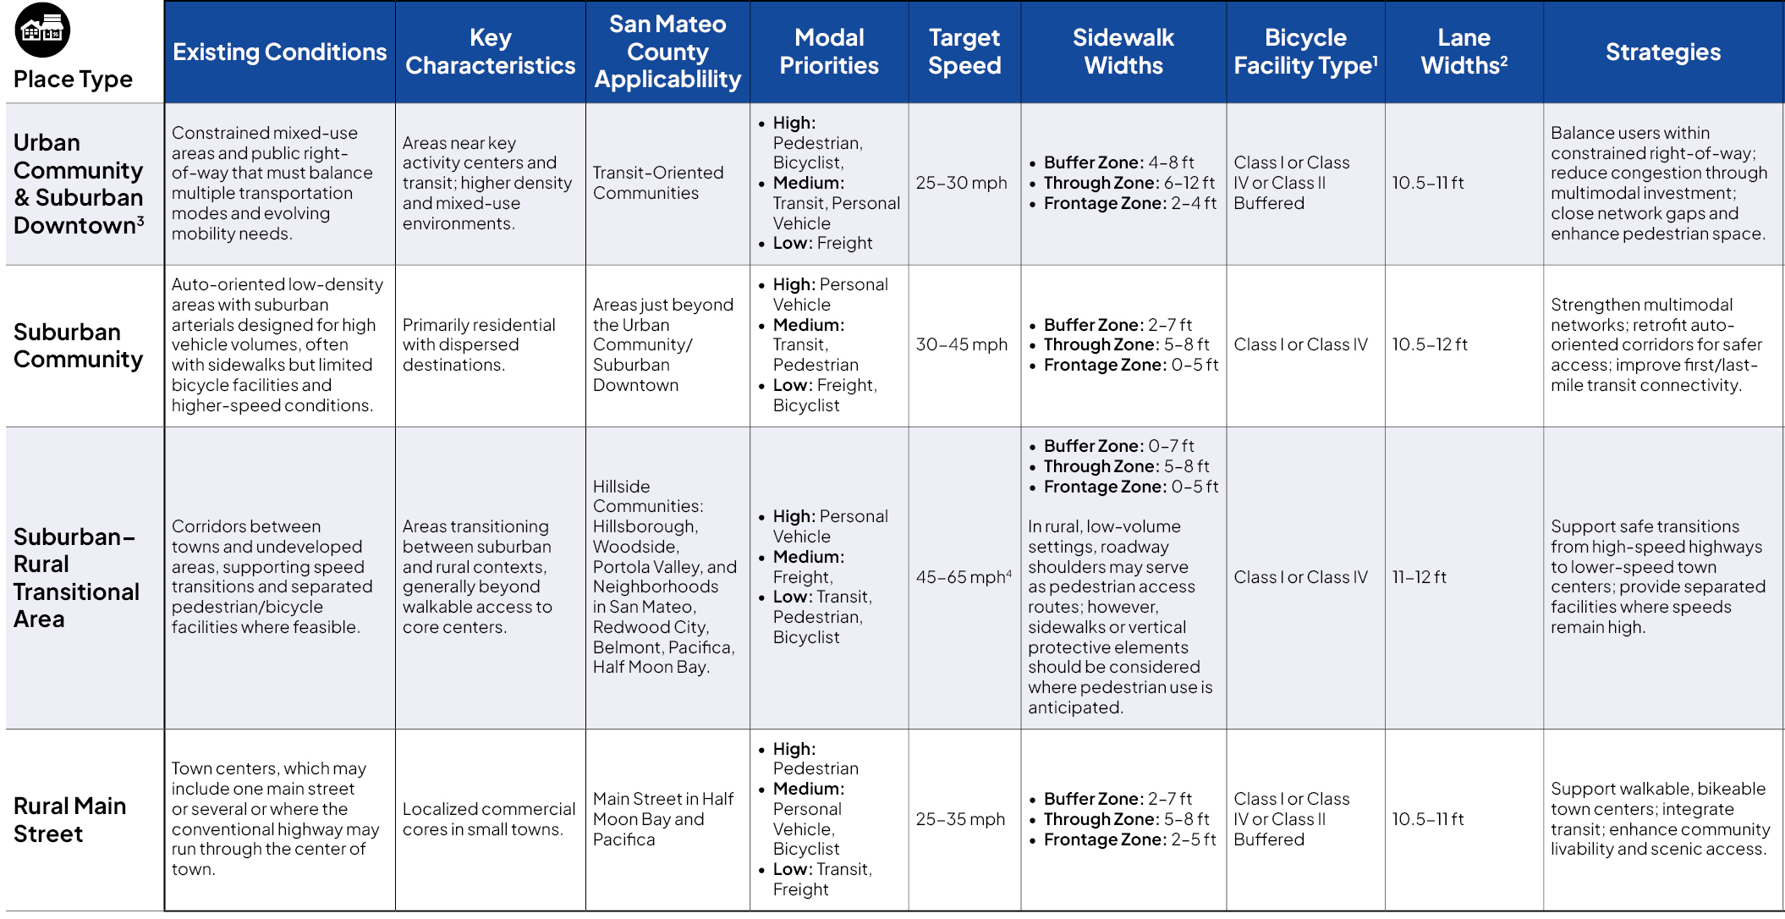
Place Type Design Expectations
Notes:
For Committees only
The Place Types framework builds on Caltrans' recently released Design Information Bulletin 94 (DIB-94), providing a context-sensitive approach to transportation planning and design.
Click – Animation
San Mateo County includes four place types, ranging from Urban Community/Suburban Downtowns and Suburban Communities to Suburban-Rural Transitional Areas and Rural Main Streets. These categories recognize that transportation solutions should reflect the surrounding land use and community context.
Click – Animation
For each place type, the guide describes the typical existing conditions, identifies where it applies within San Mateo County, establishes the modal priorities and target operating speeds, recommends appropriate pedestrian and bicycle facilities, and outlines strategies that agencies should consider when planning and designing projects.

Slide 16
Project Examples
Hillsdale Boulevard

Slide 17
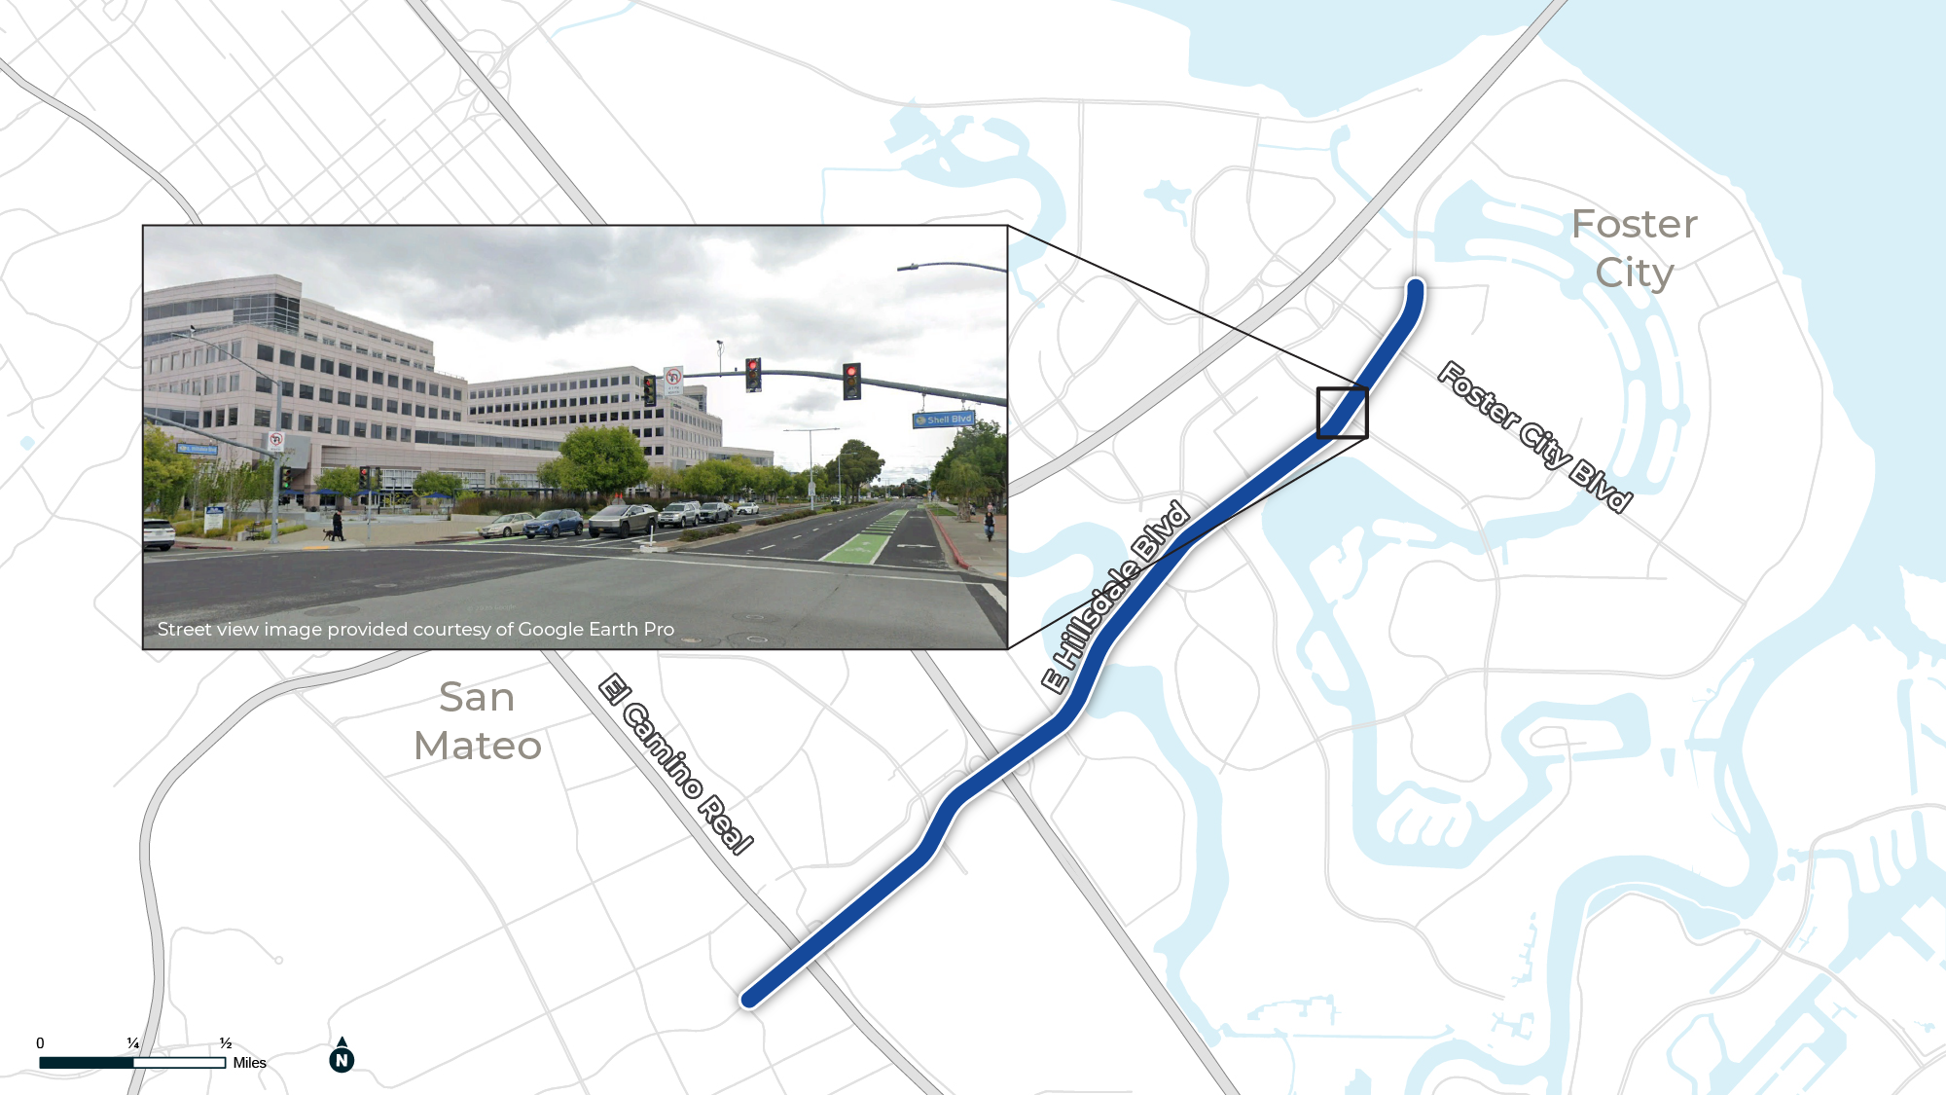
Existing Conditions & Key Characteristics
Hillsdale Blvd, San Mateo & Foster City
Existing:
Six-lane arterial in Foster City transitioning to a four-lane roadway with parking in San Mateo.
Proposed:
Class IV in Foster City, pending feasibility study, with a shared vehicle lane or grade-separated crossing in San Mateo.

Slide 18
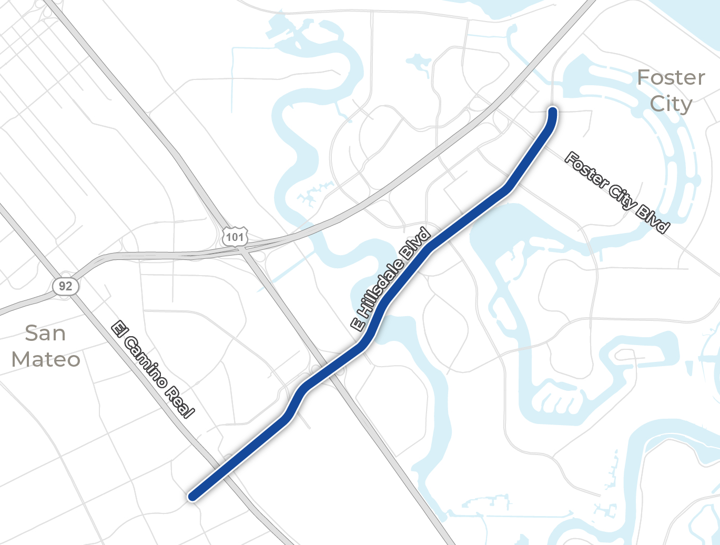

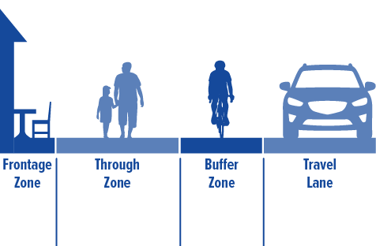





How to Use Place Type Guidance
Place Type
Suburban Community
Modal Priorities
Sidewalk & Lane Widths (feet)
High
Med
Low
0-5
5-8
2-7
10.5-12
Target Speed
30-45 mph
Bike Facility Type
Class I or Class IV

Slide 19
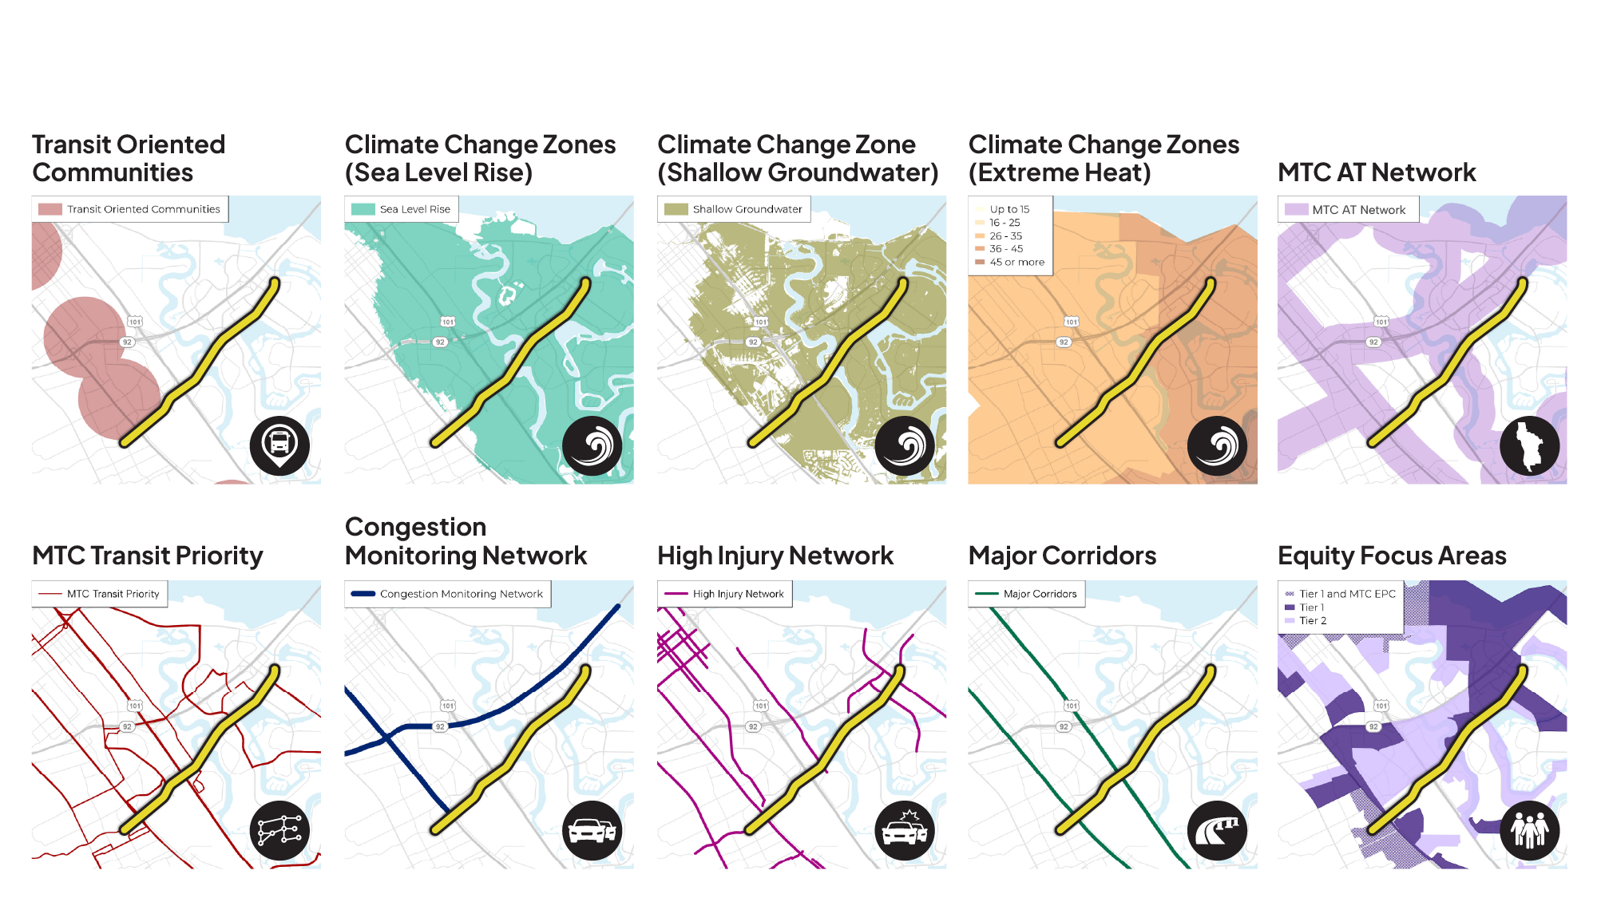
Focus Geographies – Hillsdale Boulevard

Slide 20
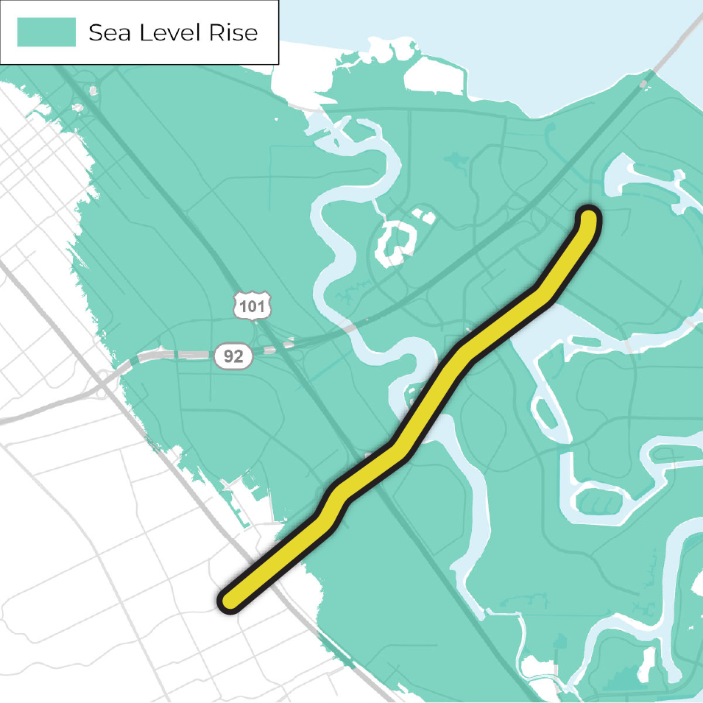
How to use Focus Geography Strategies: Climate Change Zones (Sea Level Rise)
Project Strategies
Elevate or protect vulnerable roadways
Develop Blue/Green corridors for flood management
Key Partners
One Shoreline
County Sustainability Department

Slide 21
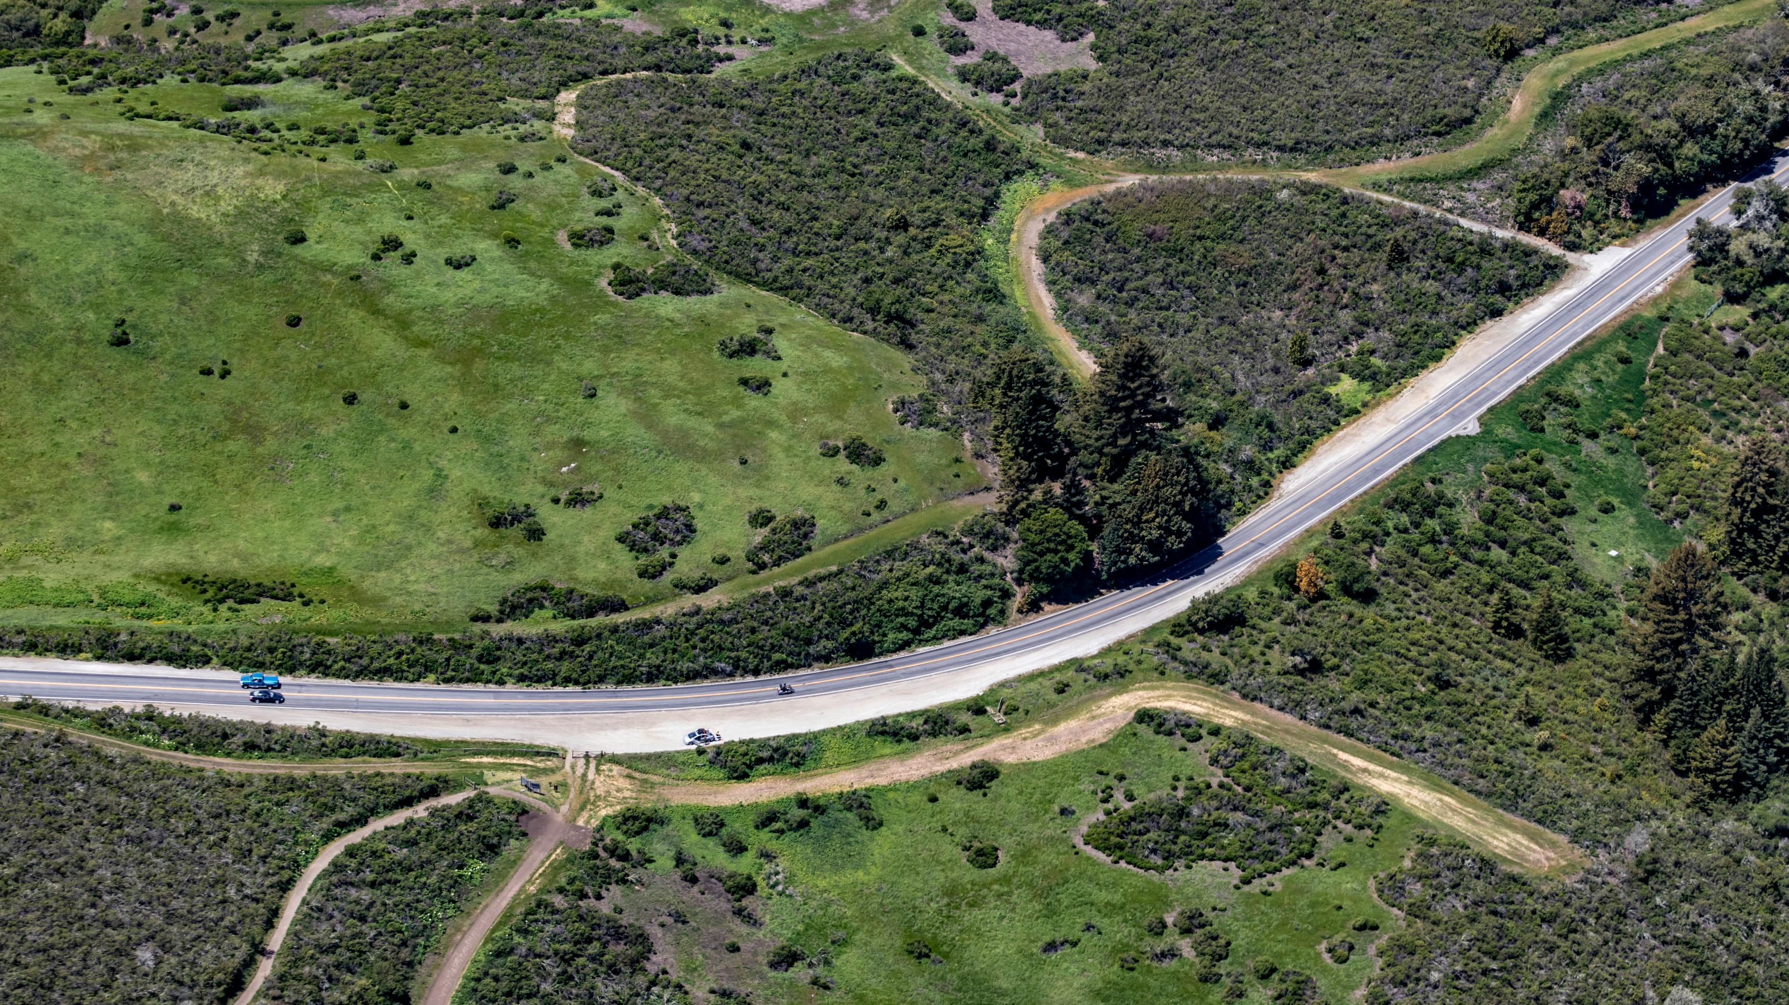
SECTION 03
DRAFT PROJECT LIST
SECTION 02

Slide 22
What is a Regionally Significant Project?
Meets any one of the following:
Expands or reduces capacity of major roadways
Expands or reduces rail network or stations
Adjusts transit service levels
Changes cost of transportation system (e.g. tolling or transit fares)
Total estimated cost over $250 million
Notes:
The CTP project list will only include projects that meet MTC’s “regionally significant” criteria.

Slide 23
How Are Other Projects Captured?
Programmatic Funding Categories
Covers smaller transportation efforts that are not regionally significant
Most local jurisdiction projects fall within these categories rather than being listed individually
Categories include: Active Transportation, Intelligent Transportation Systems (ITS), Grade Separations, and Local Streets & Highways

Slide 24
Why Generate a Project List?
How the list will inform the CTP
How the list will inform Plan Bay Area 2060
Better Understanding of Local Priorities
The CTP list is unconstrained
Identify Projects and Initiatives that Need Additional C/CAG or SMCTA Support
MTC will ask for a financially constrained list
Each county gets a total projected budget
Position Projects for Regional Funding Success
MTC will share regional goals and project priorities
These goals will be used to pare down the CTP list
Notes:
List of local and regional programs:
SMCTA Strategic Plan Pipeline Projects
2024 Pedestrian & Bicycle Program Cycle 7
Shuttle Program Call for Projects FY24/25
Transportation Demand Management (TDM) Cycle 3
2025 Final Highway Program Funding
2025 Cycle 1 Measure W Regional Transit Connections (RTC)
US 101 North County Multimodal Strategy
US 101 Mid County Multimodal Strategy
US 101 South County Multimodal Strategy
101 Corridor Connect (Active 101)
PBA 2050+
PBA 2050

Slide 25
City of Menlo Park Priority Projects
EXAMPLE SLIDE
Middle Avenue Bike and Pedestrian Undercrossing
Willow Road Class IV Bike Lanes
Middlefield Road Improvements
Sand Hill and Santa Cruz Bike and Pedestrian Improvements
Marsh Road Bike Improvements
Identified Regionally Significant Project(s)
Ravenswood Avenue Grade Separation Project
Note: Bold projects are Regionally Significant
Notes:
These 5 projects were shared by Menlo Park staff as their top local priorities. None of the top 5 are regionally significant, but the city is advancing one regionally significant project.
The other five projects will be funded within our local funding categories including: Local Roads & Highways, Active Transportation, Transit, and Grade Separations

Slide 26
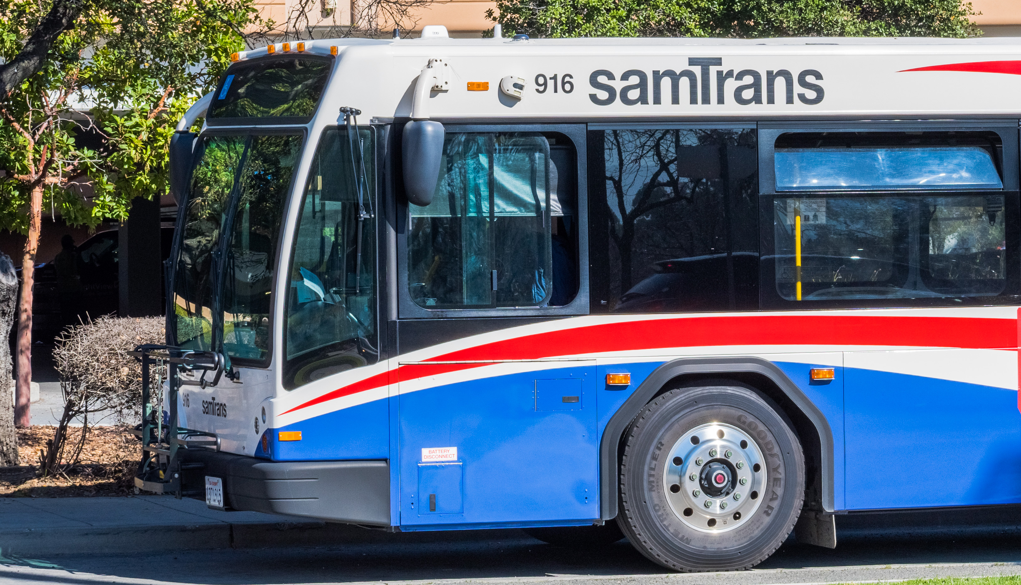
SECTION 04
DRAFT CTP INITIATIVES

Slide 27
Draft CTP Initiatives
Established Initiatives
Safe Routes to School
Shuttles
Transportation Demand Management
Community-Based Transportation Plans & Benefits
Intelligent Transportation Systems
Emerging Initiatives
Autonomous Vehicle Integration
E-Devices & Bikeshare
Green Streets & Climate Resilience
Mobility for Older Adults
Notes:
Initiatives are efforts our agencies can lead, either on our own or together.
We can advance them by going after outside grants or other means
Some involve directly helping cities move work forward

Slide 28
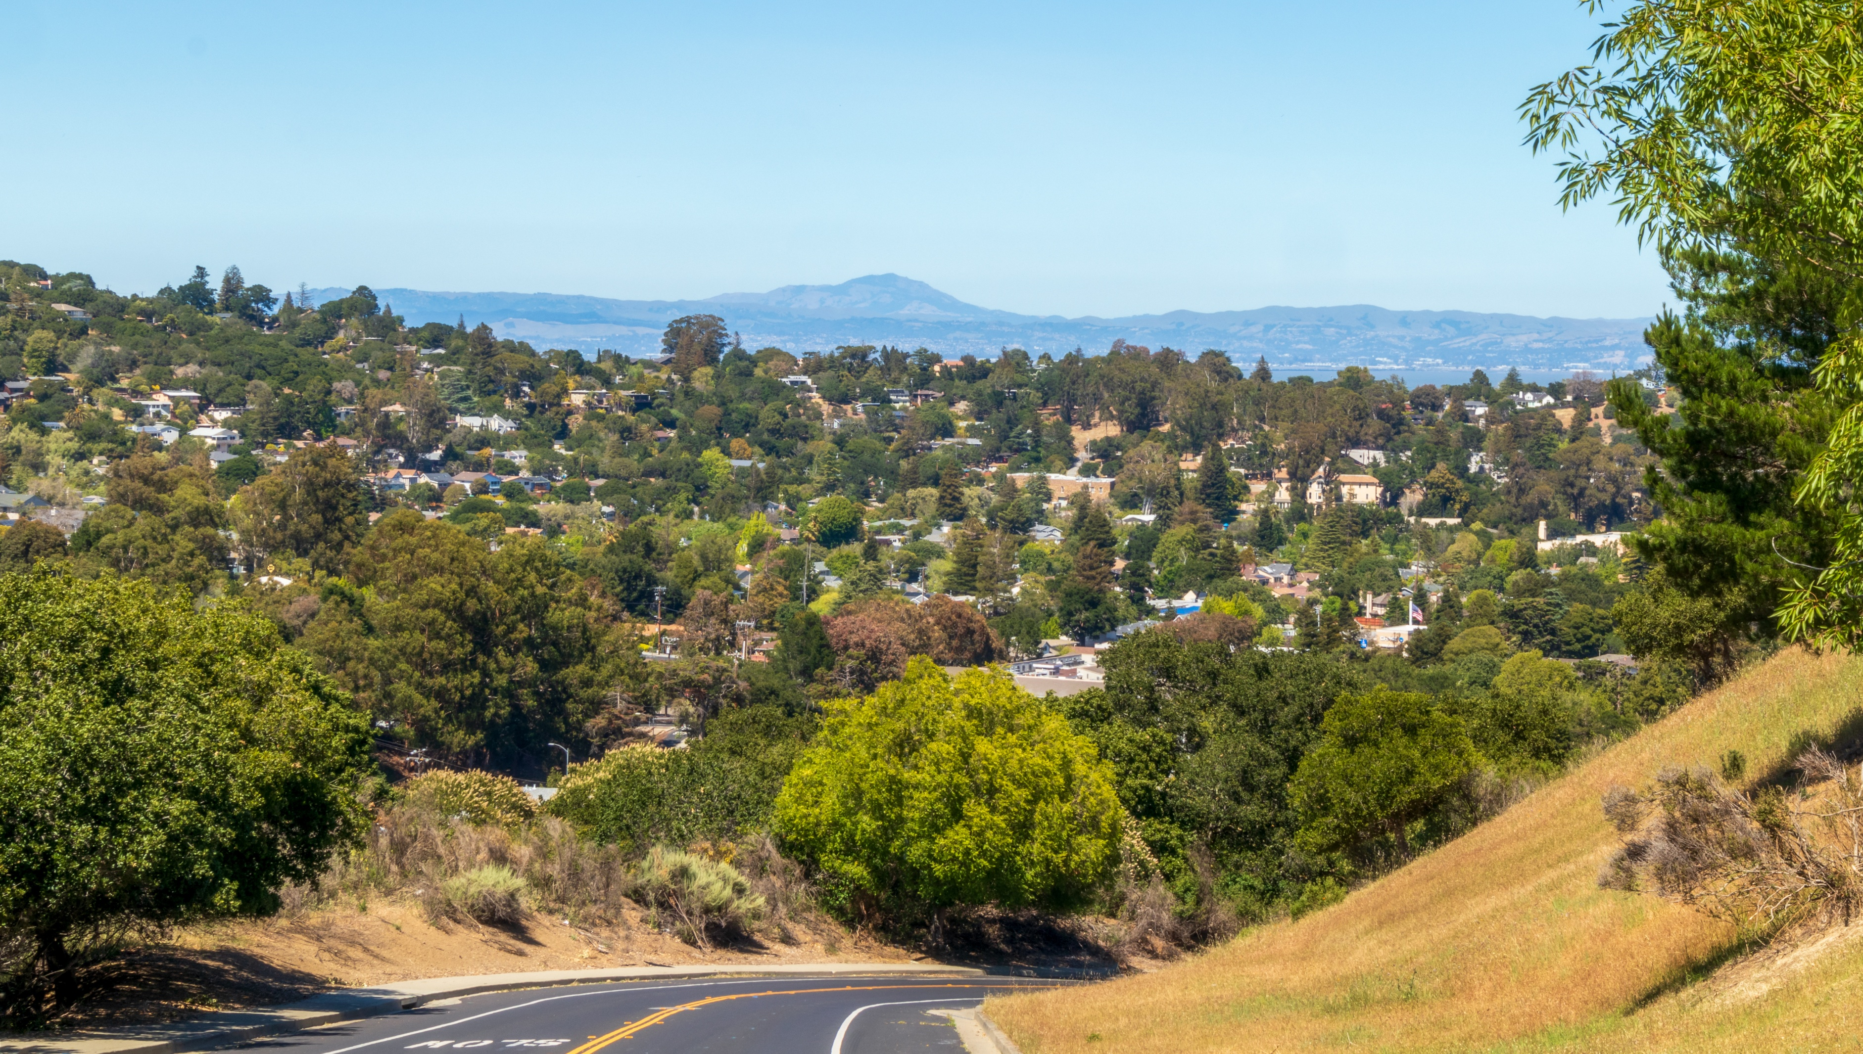
SECTION 05
NEXT STEPS

Slide 29
Today we are looking for feedback on…
Vision and Goals: do these resonate with you?
Project List: are these the right local projects?
Initiatives: does this mix of initiatives address your key transportation concerns between now and 2050?
What’s missing: anything you’re not seeing in this update that you think the CTP should address?
Notes:
Are these the right projects to be considered?

Slide 30
Upcoming milestones and schedule
Focus groups and CBO engagement through the Fall
Roadshow is touring through Oct.
Draft CTP in Winter 2027 – draft will be circulated for public review

Slide 31
Project Examples
Highway 1/Manor Drive

Slide 32
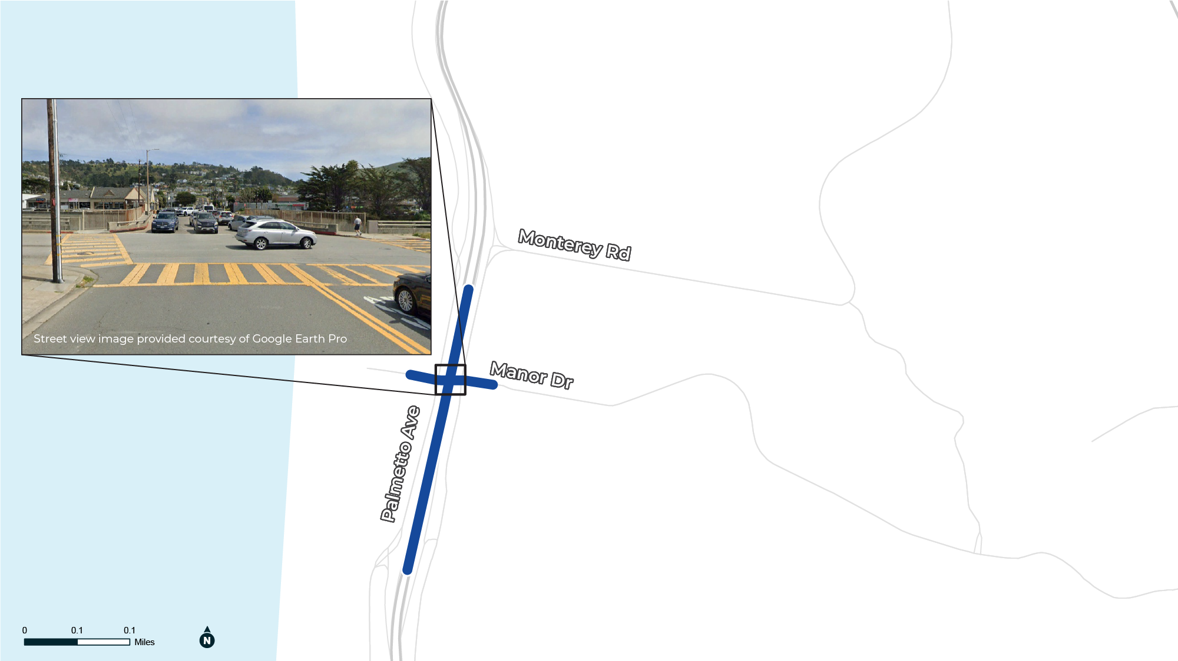
Existing Conditions & Key Characteristics
Manor Drive, Pacifica
Existing:
Existing highway overcrossing with constrained capacity and limited multimodal connectivity.
Proposed:
Widen or replace the overcrossing, new traffic signals, and improved improve multimodal access and traffic circulation of on/off ramps.
Notes:
Manor Drive Overcrossing

Slide 33
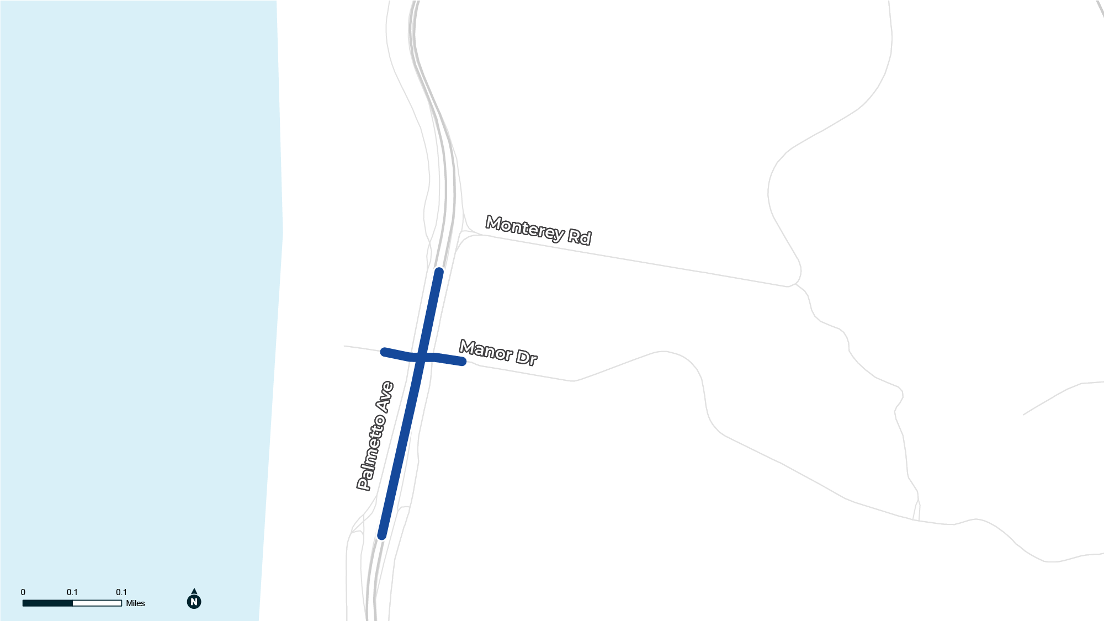
Place Type Strategies
Place Type
Rural Main Street
Modal Priorities
Sidewalk & Lane Widths (feet)
High
Med
Low
2-5
5-8
2-7
10.5-11
Target Speed
25-35 mph
Bike Facility Type
Class I or Class IV or Class II Buffered

Slide 34
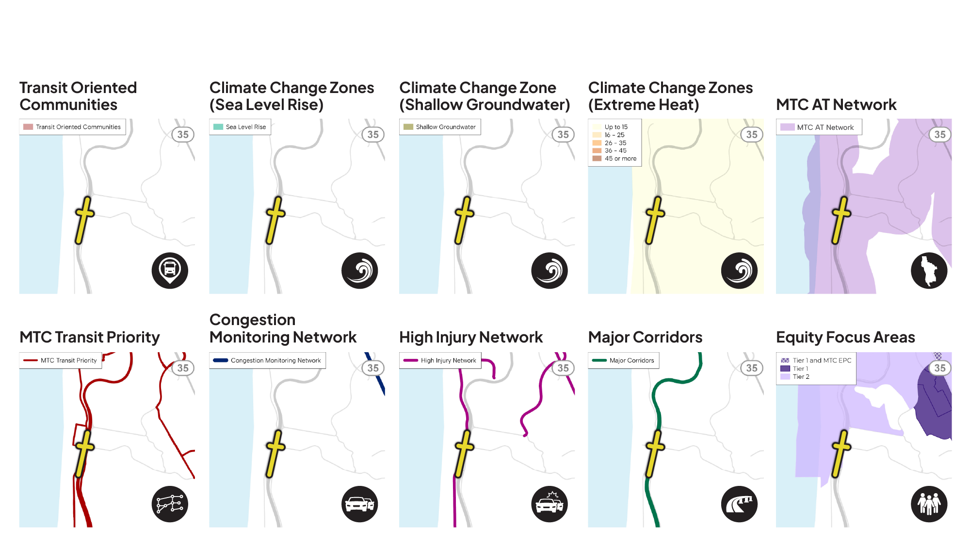
Focus Geographies – Manor Drive
Notes:
HIN covers all three modal networks

Slide 35
Community members shared… | Input source
 | Committees | CBO Interview | Plan & Data Review
A desire to walk, bike, and take transit more often, but they are deterred by concerns related to safety, comfort, network gaps, and transit frequency | X | X | X
A desire for more transit service options to meet senior travel and non-work needs (CBOs find themselves trying to fill gaps) | X | X
That travel to and from the coast is challenging | X | X | X
Mixed feeling about AVs and E-bikes | X
That Caltrain’s electrification is a great success! | X |  | X
A desire for more local options to get kids to/from school and people to/from Caltrain and BART | X
A desire for transformational improvements on arterials and highways especially Highway 1 and El Camino Real | X | X | X
Notes:
Give audience 1 minute to read the slide

Slide 36
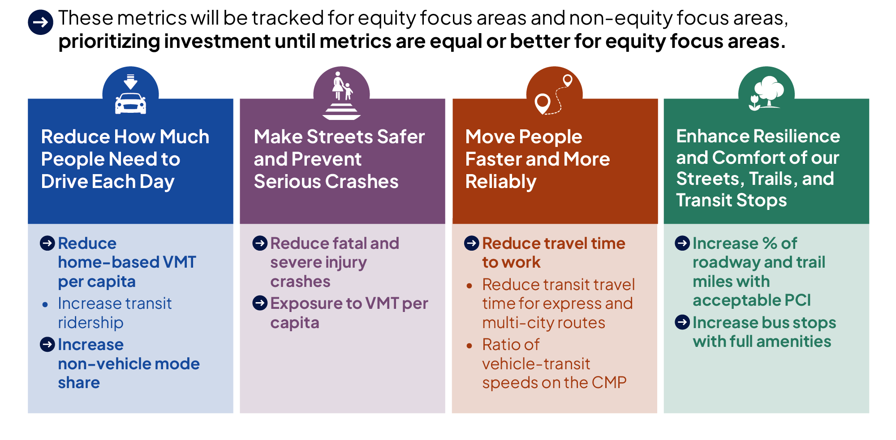
What Are We Measuring?
Notes:
These are our proposed performance metrics for the CTP update. The list is short so that tracking updates is achievable. They are organized under each of our goals. For metrics that are available spatially, we will compare outcomes for equity focus areas and non-equity focus areas to make sure that the county is removing transportation inequities over time.
Equity before and after comparison: under the previous C/CAG Equity focus area definition, 21% of county households were included. With the new definition, 49% are included and the definition includes two tiers to help us address needs of the most burdened households as well as the needs of those that are getting by but still need more support than the average San Mateo County household.

Slide 37
Why generate a project list?
One consolidated list of transportation projects in San Mateo County to inform the CTP update and MTC’s next Plan Bay Area update.
CTP Project List Actions
How this list will inform the Plan Bay Area project list
Document Project List Alignment with CTP Goals
Identify any project type gaps that need staff support
The CTP list is unconstrained
There is no cap on dollar value or number of projects
Model Projects to Forecast Multimodal Performance
Deliver model outputs to MTC
MTC will ask for a financially constrained list
Each county gets a total project budget
Identify Near-Term CTP Actions
Document 10-year priority investments
MTC will share regional goals and project priorities
These goals will be used to pare down the CTP list
Notes:
List of local and regional programs:
SMCTA Strategic Plan Pipeline Projects
2024 Pedestrian & Bicycle Program Cycle 7
Shuttle Program Call for Projects FY24/25
Transportation Demand Management (TDM) Cycle 3
2025 Final Highway Program Funding
2025 Cycle 1 Measure W Regional Transit Connections (RTC)
US 101 North County Multimodal Strategy
US 101 Mid County Multimodal Strategy
US 101 South County Multimodal Strategy
101 Corridor Connect (Active 101)
PBA 2050+
PBA 2050

Slide 38
How is the project list generated?
Gather sources
Compiled projects from 12 countywide initiatives
1
Normalize
Combined projects into one shared schema
2
Remove duplicates
Some projects showed up in multiple countywide initiatives
3
Filter to only “large” projects
Filtered to projects of countywide significance – smaller projects addressed programmatically
4
Confirm project details with cities
Verified projects and project information with Public Works staff in each city/town
5
Notes:
List of local and regional programs:
SMCTA Strategic Plan Pipeline Projects
2024 Pedestrian & Bicycle Program Cycle 7
Shuttle Program Call for Projects FY24/25
Transportation Demand Management (TDM) Cycle 3
2025 Final Highway Program Funding
2025 Cycle 1 Measure W Regional Transit Connections (RTC)
US 101 North County Multimodal Strategy
US 101 Mid County Multimodal Strategy
US 101 South County Multimodal Strategy
101 Corridor Connect (Active 101)
PBA 2050+
PBA 2050

Slide 39
What is in the project list?
Summary of Projects by Type | Number of Projects | Costs in $M
Transit | 11 | 5,351.2
Regional Transit | 8 | 53.6
Highway | 26 | 1,502.3
Pedestrian & Bicycle | 59 | 914.4
Multimodal | 7 | 634.6
Shuttle Program | 26 | 13.1
ACR/TDM | 32 | 9.2
Grade Separation | 3 | 8.3
Other | 5 | 1,110.6
Unclassified (101 Corridor Connect & PBA 2050+ blocks) | 50 | 2,952.0
Grand Total | 227 | 12,549.3

Slide 40
What feedback do you have on…
Vision and Goals: do these resonate with you?
Project List: are these the right project priorities locally? For the county?
Programs: does this mix of programs address your key transportation concerns between now and 2050?
What’s missing: anything you’re not seeing in this update that you think the CTP should address?

Slide 41
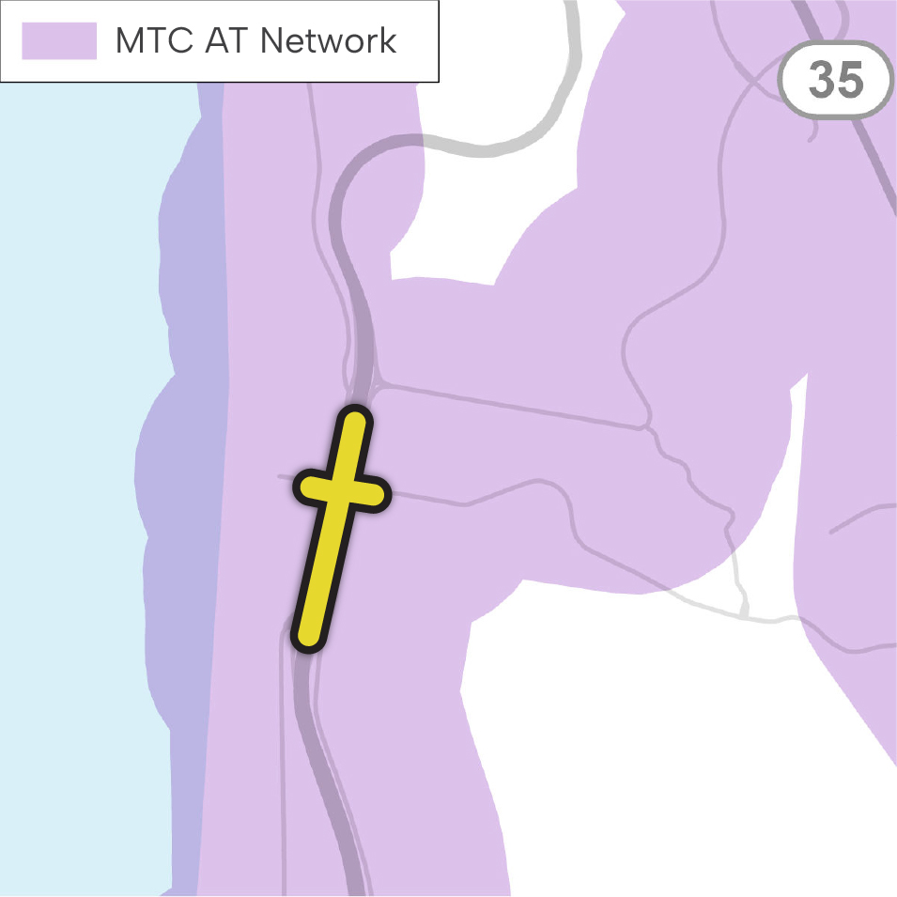
How to use Focus Geography Strategies: MTC AT Network
Project Strategies
Build protected or low stress bike facilities
Enhance sidewalks and pedestrian crossings
Key Partners
Local Jurisdictions
SMCTA
MTC

