Slide 1

ATTACHMENT 1
San Mateo County 101 Express Lanes
Initial Performance Study
Notes:
Today’s presentation summarizes the initial performance of the 101 Express Lanes after opening.
This is an early, data-driven look at how the lanes are operating under real-world conditions.
It’s important to frame this as an initial checkpoint, not a final verdict—we will continue to refine and update the analysis as more data becomes available.

Slide 2
Agenda
Background & Rules
03
Study Purpose
04
Data Sources
05
Analytical Limitations
06
Benefit Assessment
07
Key Takeaways
20
Next Steps
21
Notes:
I’ll start with the purpose of the study and the data sources used.
Then I’ll walk through performance results tied directly to the benefits identified in the EIR.
I’ll close with key takeaways, limitations, and next steps.

Slide 3
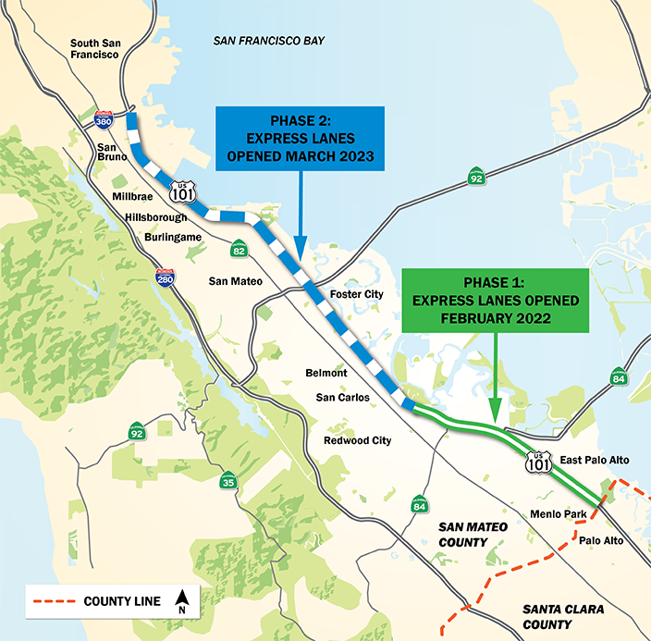
Background & Operating Rules
Express Lane Objectives
  Maintain travel speeds of 45 mph or greater
  Improve mobility, reliability, and efficiency
  Integrate with the regional express lanes network
Timeline
Operating Rules
  Hours: 5:00 a.m. – 8:00 p.m., Monday–Friday
  FasTrak® required
  Toll-free: HOV 3+, buses, motorcycles using FasTrak® Flex
  Half-price tolls: HOV 2 using FasTrak® Flex
  Eligible clean-air vehicles (ended 9/30/25)
2022
Phase 1
HOV to Express Lane Conversion
7 miles
2023
Phase 2
New Managed Lane Added
15 miles
Notes:
The express lanes were designed to maintain reliable speeds of 45 mph or greater during peak periods.
The operating rules—hours, eligibility, FasTrak Flex use—are consistent with regional express lane standards.
These lanes are actively managed facilities, not static HOV lanes, which is a critical distinction for understanding performance.

Slide 4
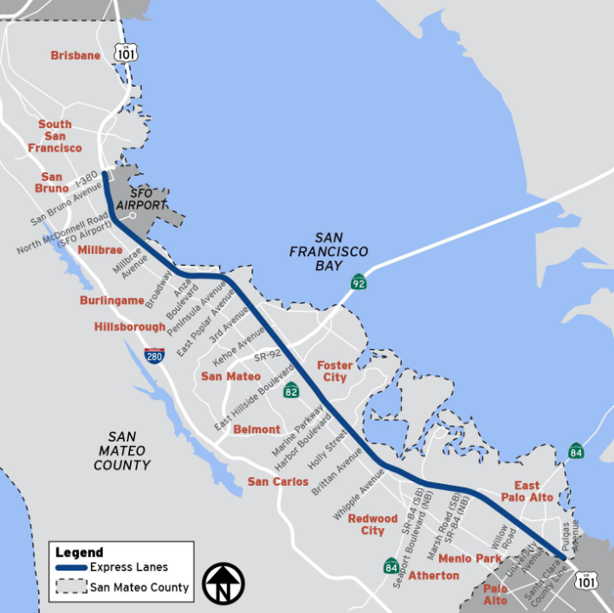
Study Purpose
Evaluate 101 Express Lanes and the corridor performance by assessing impacts across the following benefits*:
  Reduce congestion and delays throughout the corridor
  Improve travel time and reliability for express lane users
  Encourage carpooling and transit use
  Increase person throughput, measured by the number of people moved
  Use modern technology to actively manage traffic
*Benefits are drawn from the Environmental Impact Report, with initial safety data added.
Notes:
The purpose of this study is to evaluate whether the express lanes are delivering the benefits identified during environmental clearance.
Those benefits include reducing delay, improving reliability, encouraging carpooling and transit use, increasing person throughput, and using technology to actively manage traffic.
Safety was added as a benefit area, with the understanding that safety data has a longer reporting lag.

Slide 5
Data Sources
The study relies on a combination of publicly available data and internal operational data.
Traffic & Performance
Toll Operations
Safety
Data
  Traffic Volume, speed, travel time (95th Percentile Travel Time, Planning Time Index (PTI))
  Pre-Project Data (2018) and Post-Project (2024)
  Annual Average Daily Traffic (2016 - 2023)
Reports
  Caltrans Performance Measurement System (PeMS)
    Station Hour
  Caltrans Traffic Census
    Annual Average Daily Traffic
  Publicly available
Data
  Express Lane Performance, Express Lane Usage, Dynamic Pricing, Occupancy Declarations, Person Throughput
  Post-Project Data Only (2023-2025)
Reports
  Bay Area Infrastructure Financing Authority (BAIFA)
    Trips
    Publicly available, aggregate only
Data
  Collision Locations, Safety Trends
  Pre-Project Data (2016-2018) and Post-Project Data (2023)
Reports
  Statewide Integrated Traffic Records System (SWITRS):
    Corridor-Level Safety Analysis
  Publicly available, limited through UC Berkeley
Notes:
The analysis relies primarily on Caltrans PeMS data and the Caltrans Traffic Census.
These are publicly available, industry-standard data sources.
Toll system data supplements this by providing higher-resolution insight into express lane operations that probe data alone cannot provide.

Slide 6
Analytical Limitations
These factors were considered when interpreting study findings and results.
Phased Implementation of the Corridor
Applied consistent metrics and used the GP lane as a baseline
Occupancy Data is self-reported
Verification technology and targeted enforcement needed. Evaluation considers varying levels of occupancy misdeclaration
Few Peer Corridors for comparison
Used closest regional matches; Peer partnerships to be expanded
Post-Pandemic Traffic is still lower than pre-2019
Interpreted results in context of regional recovery
Safety Data only covers eight to nine months
Results are preliminary and will be updated when more data is released
Notes:
There are several important limitations to keep in mind when interpreting results.
The corridor opened in phases, so performance varies by segment.
Occupancy data is self-reported, which is an industry-wide limitation.
Traffic patterns are still stabilizing post-pandemic.
Safety data currently covers only nine months, which is not sufficient for defensible conclusions.
We’ve intentionally applied consistent metrics and used GP lanes as a baseline to keep the analysis conservative.
Limitations
How It Was Addressed
Post-Implementation Data Set. Limited post-implementation period; Phase 2 lane addition limits direct before-and-after comparisons.
Applied consistent performance measures across time periods and cross-checked results using multiple data sources; for Phase 2, used the leftmost general-purpose lane from the pre-implementation period as a comparison baseline
Post-Pandemic Travel Patterns. Regional travel behavior shifts affect baseline conditions
Interpreted results within the context of regional trends and recommended ongoing data evaluation to support future analyses
Occupancy Data. Relies on self-reported toll system declarations
Acknowledged limitations and identified the need to verify occupancy declarations
Transit Data. Limited availability of consistent corridor-level data
Excluded transit performance analysis and recommended pursuing data partnerships to enable future analysis
Safety Data. SWITRS data only available through 2023; limitations with selected comparison corridor.
Recognized data limitations and recommended reassessing safety impacts as additional data becomes available

Slide 7
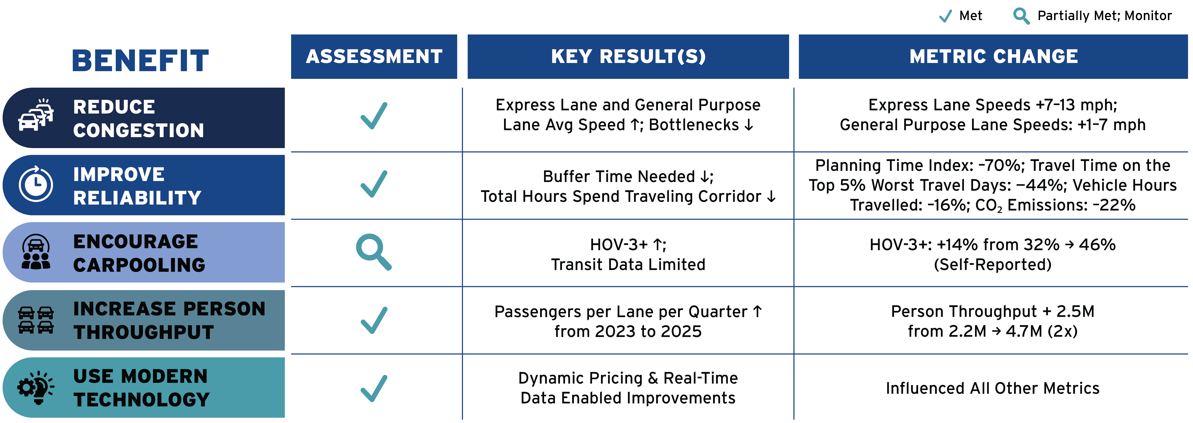

Overall Corridor Performance
Summary of results across the study’s key performance goals
Performance gains vary by project phase, with the most significant improvements occurring in Phase 2 segments where new managed lane capacity was added. Findings should be interpreted in the context of post-pandemic travel pattern changes and increasing corridor demand.

Slide 8
Traffic Trends
Corridor-level summary of annual changes in regional traffic demand
Average Annual Daily Traffic (AADT) shows downward pandemic trends are recovering, but traffic levels in 2023 remained about 10% lower than 2019.
AM/PM Peak Period General Purpose Lane Traffic Volumes (vehicles per hour) show commute peaks have fully recovered. Peak period changes are more attributable to the Project.
Source: Caltrans Traffic Census (2016-2023)
Peak Periods: 6 am – 10 am, 3 pm – 7 pm
Source: Caltrans Performance Measurement System (2018-2024)
Notes:
While overall daily traffic remains slightly lower, peak commute periods have fully recovered.
Morning and evening peaks are now comparable to pre-pandemic levels.
This means peak-period performance changes are much more attributable to the express lanes themselves, not suppressed demand.

Slide 9
Congestion & Delay
Corridor performance results
Met Goal
Key Findings
    Average speeds increased throughout the corridor in both directions
    Bottlenecks are shorter and less severe, both in duration and physical length
    General Purpose lanes are performing better under increasing peak period demand, indicating improved corridor throughput
    Remaining congestion reflects localized interchange and roadway constraints
Supporting Data
    Express Lanes: Average speeds increased by 7–13 mph from 2018 to 2024
    General Purpose Lanes: Average speeds increased by 1–7 mph from 2018 to 2024
Location-Specific Observations
    Severe bottlenecks are shorter and less intense:
      Near I-380 SB (30→65 mph)
      University Ave SB (30→45 mph)
      Ralston Ave NB (< 30→45 mph)
    Persistent bottlenecks remain near SR-92 and SFO
Source: Caltrans Performance Measurement System (2018-2024)
Notes:
Average speeds increased throughout the corridor in both directions.
Express lanes saw speed increases of 7 to 13 mph.
General purpose lanes also improved by 1 to 7 mph, which is a key point—this is not just a benefit to tolled users.
Bottlenecks are shorter and less severe, even where congestion still exists.

Slide 10
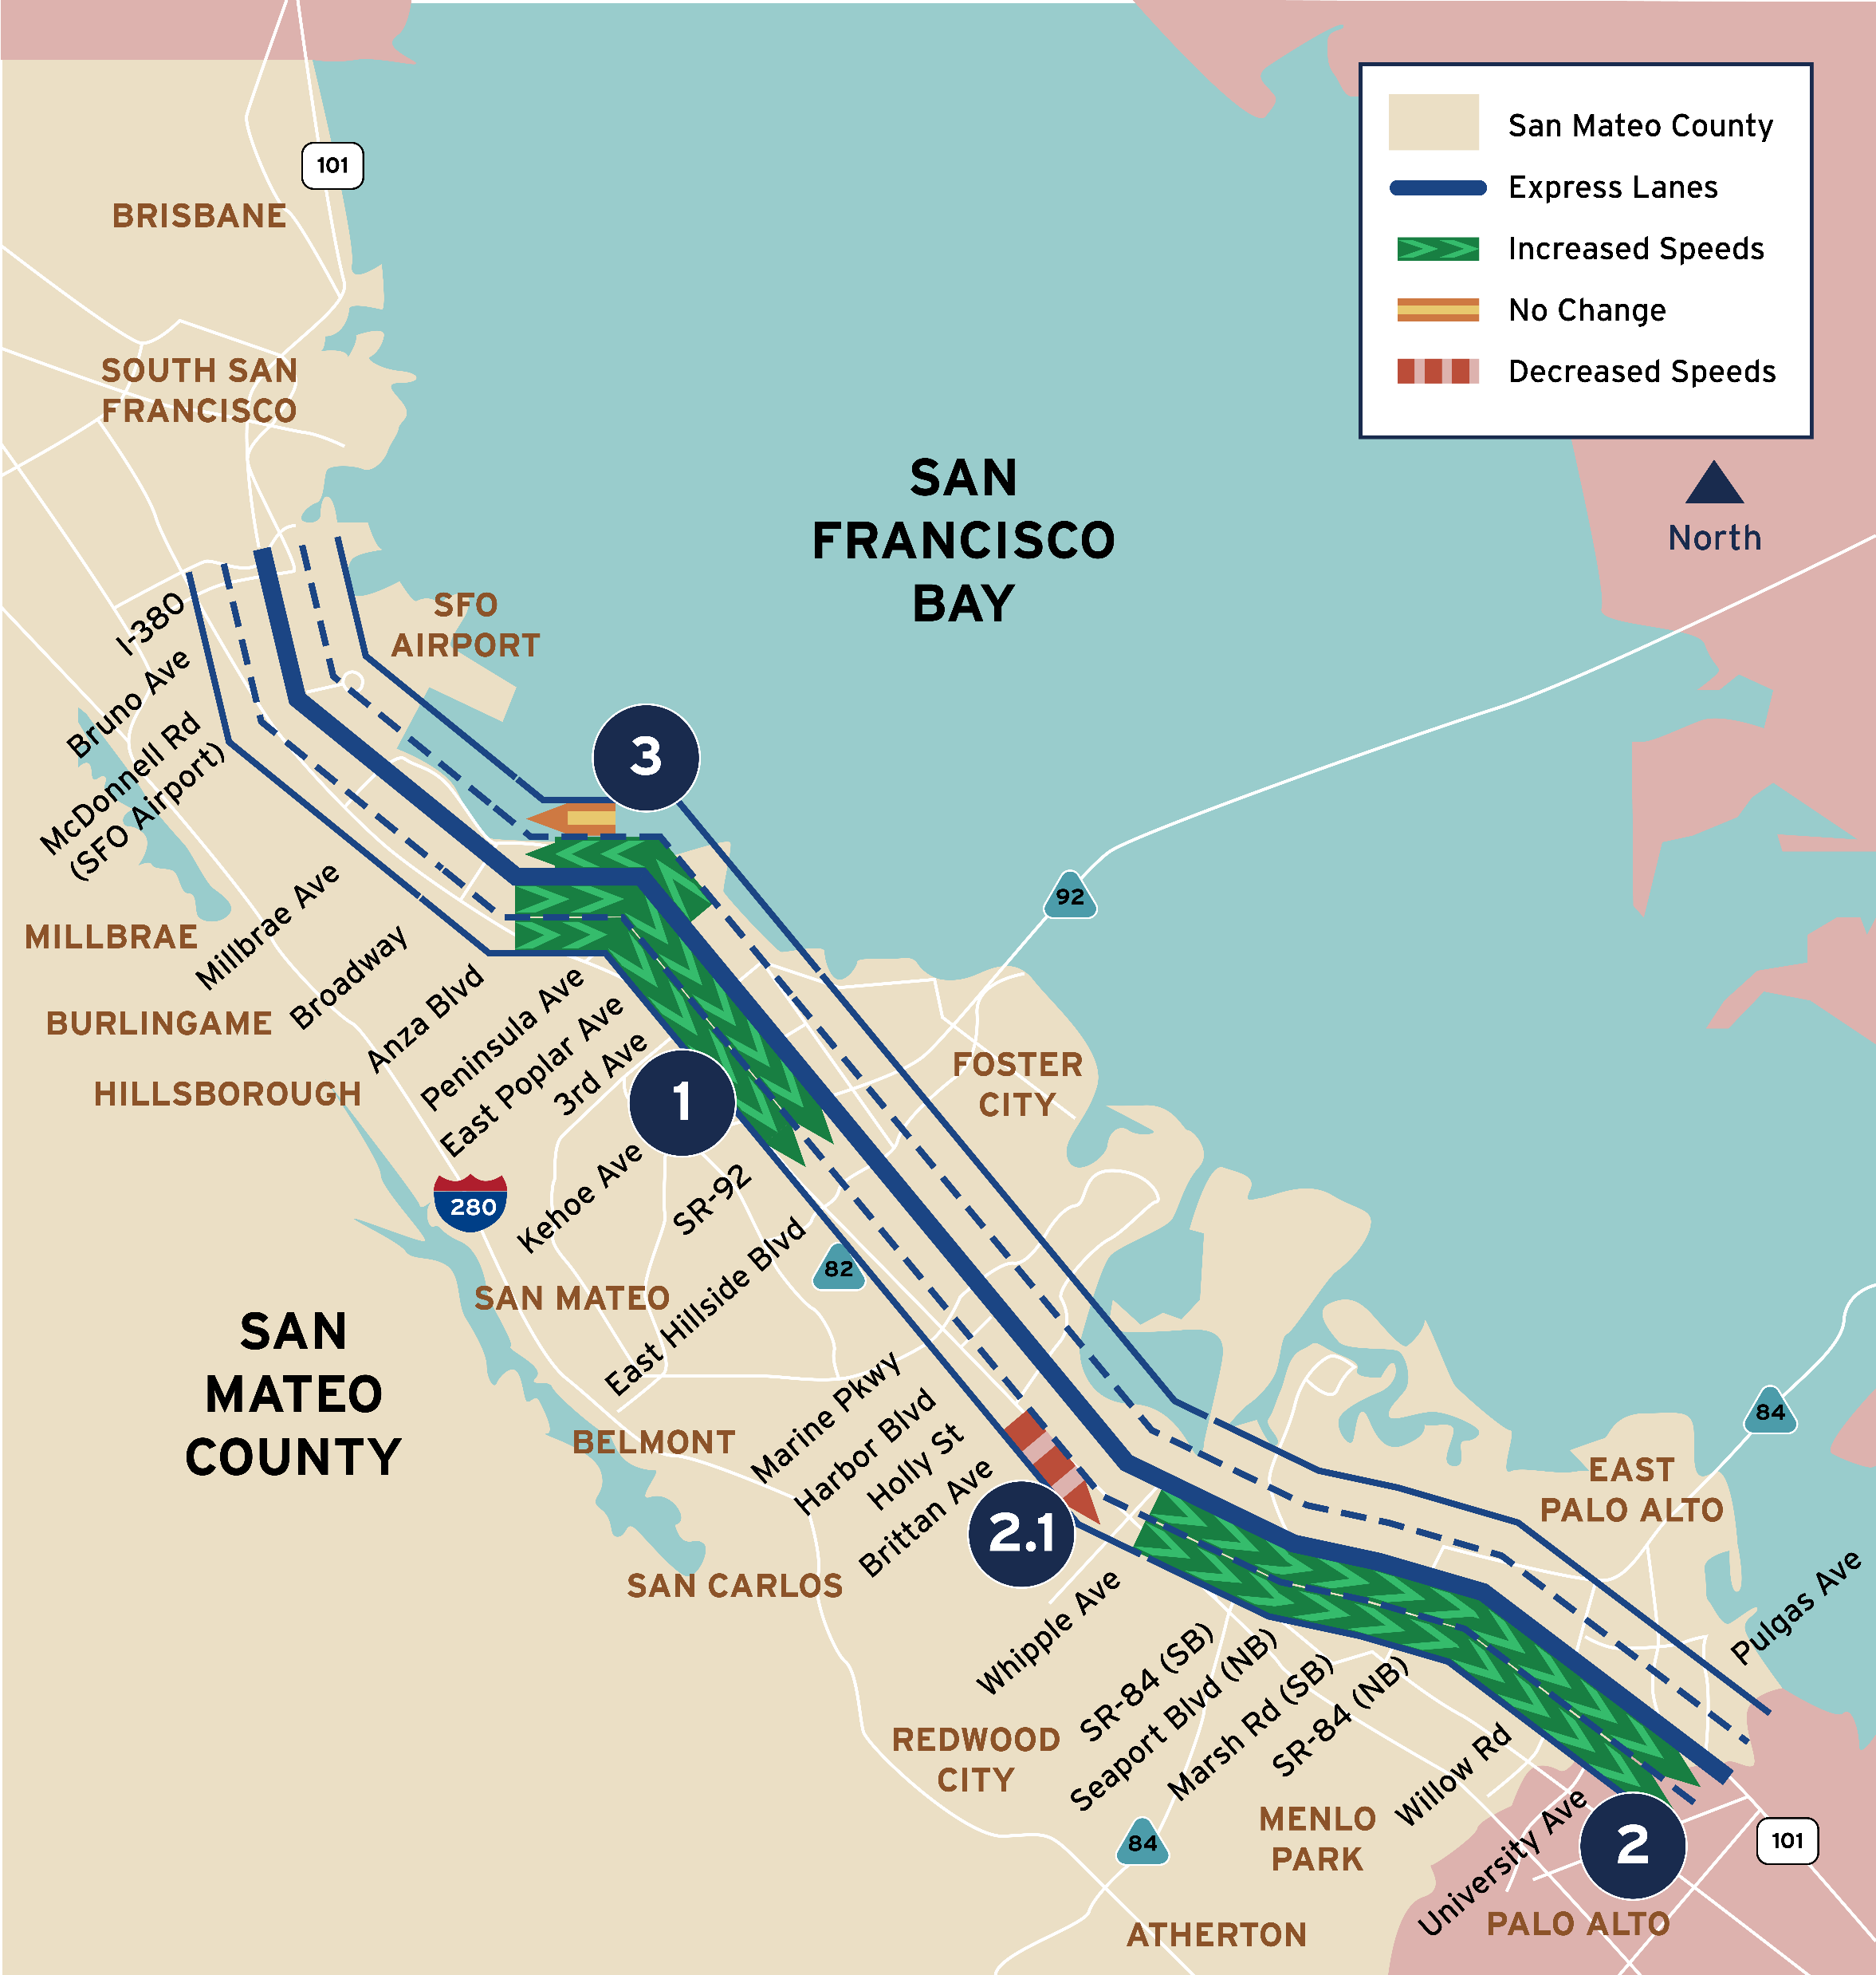
Hot Spots (AM)
Southbound at Hillsdale Blvd is fully resolved Express Lane + General Purpose.
Southbound at University Blvd is fully resolved Express Lanes + General Purpose.
  2.1. Small bottleneck appeared at Whipple.
Northbound south of Millbrae Ave eases for Express Lanes and General Purpose is static.
Source: Caltrans Performance Measurement System (2018-2024)
Notes:
Orient them on how to read the map
Several historic southbound bottlenecks are now fully resolved.
Others are noticeably shorter and less intense.
Remaining congestion is largely tied to known interchange constraints rather than express lane operations.

Slide 11
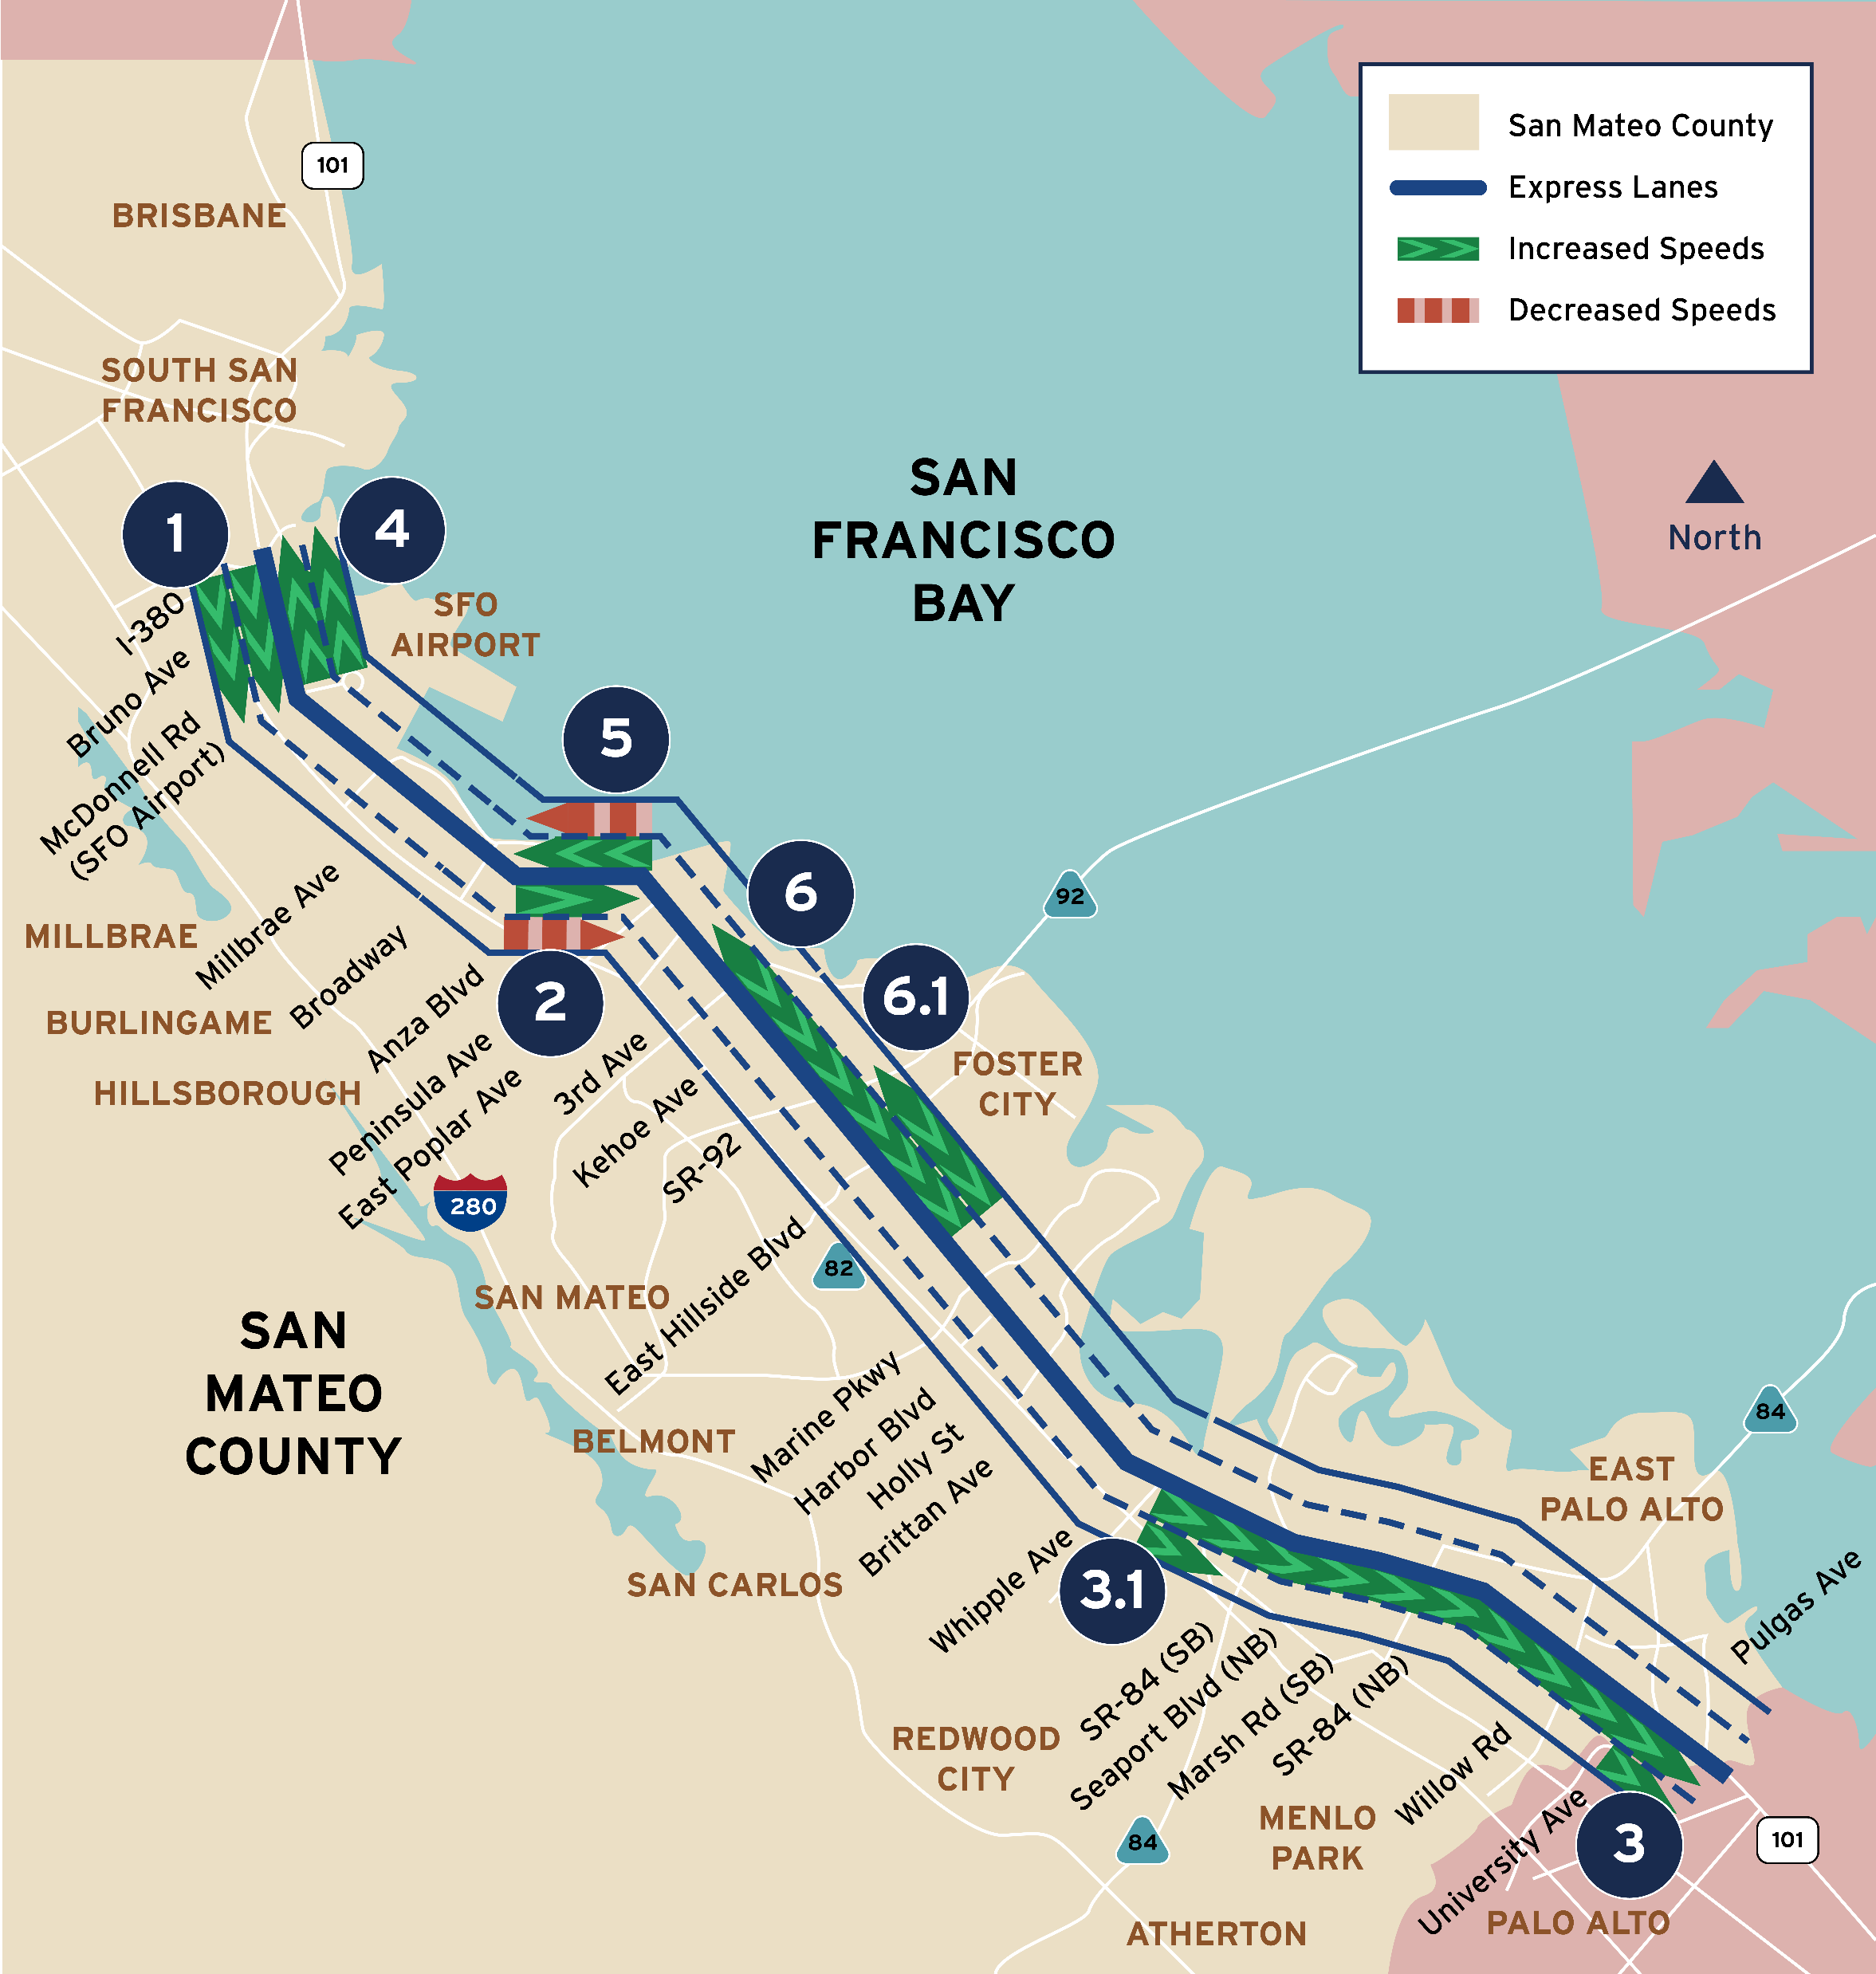
Hot Spots (PM)
Southbound between I-380 and Millbrae Ave is fully resolved Express Lanes + General Purpose
Southbound between 3rd Ave and Millbrae Ave eases for Express Lanes, but the hotspot appears for General Purposes
Southbound at University Ave eases Express Lanes + General Purpose
    3.1. Secondary Southbound bottleneck at SR-84 eases for General Purpose
Northbound at I-380 is fully resolved Express Lanes + General Purpose
Northbound between Millbrae Ave and 3rd Ave eases for Express Lanes, but the hotspot appears for General Purpose
Northbound bottleneck at between 3rd Ave and Ralston Ave eases for Express Lanes
    6.1. Northbound bottleneck at SR-92 eases for General Purpose
Source: Caltrans Performance Measurement System (2018-2024)
Notes:
Similar patterns appear northbound.
Express lanes show improvement even where GP lanes remain constrained.
This highlights how managed lanes can provide reliability even when physical bottlenecks remain.

Slide 12
Travel Time & Reliability
Corridor performance results
Met Goal
Key Findings
Performance gains are occurring despite increasing post-pandemic demand and extended peak periods across the corridor. Express Lanes deliver meaningful benefits to both direct users and the broader transportation network.
Faster & More Reliable Trips
Express Lane users experience significant travel time savings with dramatically reduced worst-day delays throughout the corridor.
Corridor-Wide Benefits
General Purpose lane reliability also improved, demonstrating system-wide gains beyond Express Lanes alone.
Improved Efficiency
Total Vehicle Hours Traveled declined corridor-wide, reflecting reduced congestion and more predictable travel patterns.
Data Source: Caltrans Performance Measurement System (2018-2024 comparison)
Notes:
Reliability is one of the strongest performance outcomes.
Express lane users experience significantly reduced worst-day delays.
General purpose lanes also show improved reliability, indicating corridor-wide efficiency gains.
These improvements are occurring despite increasing post-pandemic demand

Slide 13
Travel Time & Reliability
Express Lanes performance results
Met Goal
Key Findings
Analysis reveals improvements across all performance metrics, with Express Lanes delivering measurable benefits during peak travel periods while enhancing overall corridor efficiency.
22%
Southbound
Travel Time Savings
Average reduction with peaks
up to 30% by hour
13%
Northbound
Travel Time Savings
Average reduction with peaks
up to 20% by hour
58% SB 42% NB
Reduced Vehicle Hours Traveled
Vehicle Hour
Traveled (VHT) decline
Data Source: Caltrans Performance Measurement System (2018-2024 comparison)
Notes:
Southbound 101 drivers experienced 22% travel time savings
And northbound experienced a 13% travel time savings
SB experienced a 58% reduction in VHT and NB experienced a 42% reduction in VHT (ASK AN about tie to environmental)
This translates directly to predictability for commuters.

Slide 14
Travel Time & Reliability
Corridor performance results
Met Goal
Key Findings
Reliability improved on worst traffic days. Users need to budget less time to arrive on time, with reduced congestion and lower emissions.
Express Lane Performance
  95th percentile travel time reduced by 28–44%
  Users budget only ~30% extra time vs. free-flow
  Southbound corridor: down from 45 to 25 minutes
General Purpose Lanes Performance
  95th percentile travel time reduced by 3–14%
  Users budget only ~60–90% extra time vs. free-flow
  Pre-project: travelers needed 2.3× free-flow time
Corridor-wide VHT Reduction
  16% reduction in Vehicle Hours Traveled
Corridor-wide Environmental Impact
  22% reduction in peak-period CO₂ emissions across the corridor
Data Source: Caltrans Performance Measurement System (2018-2024 comparison)
Notes:
The 95th percentile travel time—essentially the worst travel days—improved by 28 to 44% for express lane users.
Southbound corridor travel time dropped from roughly 45 minutes to about 25 minutes on the worst days.
This translates directly to predictability for commuters.

Slide 15

Carpooling & Transit Use
Express Lanes performance results
Key Findings
Partially Met: Monitor
    Carpooling in the express lanes has increased since opening
    Growth is primarily driven by the opening of Phase 2
    Transit routes like EPX and FCX benefit from increased travel speeds and reliability
Supporting Data
    Self-reported HOV 3+ declarations increased from 32% (2023) to 46% (2025)
    Analysis assumes different levels of occupancy misdeclaration to show a range of scenarios
Data Concerns
    Performance measures rely on self-reported vehicle occupancy data, which has known limitations. Adjusting occupancy levels based on studies on other corridors is an estimation, though likely to improve accuracy. Future strategies to improve occupancy verification would help protect the integrity and reliability of the system
    While there were no readily available and complete data sources for transit use, the study recommends expanding collaboration with local transit agencies and evaluate occupancy verification technology in future study
Source: Bay Area Infrastructure Financing Authority (2023-2025)
Notes:
Update after talking about Transit Data with Peter
CAN I mention VOD?

Slide 16
Person Throughput
Express Lanes performance results
  Key Findings
  Person throughput increased by more than 2.3× since before the Phase 2 opening and by 23% from Phase 2 opening to today
  Growth reflects increased Express Lane usage distributed across all occupancy types
  Supporting Data
  Number of users, calculated from occupancy declarations, increased from approximately 2.5 million to 5.7 million passengers per lane per quarter
  Data Interpretation Notes
  Assumes HOV2 and HOV3+ misdeclaration of 50%
  Assumes all Image-Based Tolling (no FasTrak®) trips are SOV
  Range limits show passenger throughput values assuming:
    100% misdeclaration (all vehicles have one driver) and
    0% misdeclaration (passengers calculated assuming self-reported occupancy is accurate)
Met Goal
Sources: Bay Area Infrastructure Financing Authority (2023-2025)
Notes:
Person throughput increased by more than 2.5 times following the Phase 2 opening.
This reflects increased express lane usage and a higher share of HOV 3+ vehicles.
While occupancy is self-reported, the magnitude and consistency of the increase are notable.

Slide 17
Technology & Lane Management
Corridor performance results
Met Goal
The observed performance improvements are enabled by active lane management technology, including real-time traffic monitoring and dynamic pricing, which allows the system to respond quickly to changing demand and maintain reliable travel speeds
TECHNOLOGY
  Dynamic Pricing
  Real-time Telemetry (speed, volume, occupancy, travel time)
ACTIVE MANAGEMENT
  Pricing adjusts to demand
  Lane conditions monitored continuously
  Operations respond quickly to changing conditions
OUTCOMES
  Reliable Express Lane speeds
  Reduced congestion and oversaturation
  Improved travel time reliability
Notes:
These performance gains are enabled by active lane management.
Dynamic pricing responds in real time to traffic conditions.
Continuous monitoring allows operators to adjust quickly as conditions change.
This is a fundamental difference from traditional HOV lanes.

Slide 18
Safety
Commitment to Future Investigation and Reporting
Data Insufficient
Analyzing and sharing the impacts of the 101 express lanes on highway safety is a top priority
Incident data has a longer lead time than traffic data, only 9 months of data available (March – December 2023)
As a result, current dataset is not statistically valid
  Analysis will result in premature/incomplete assumptions
  Additional data needed to draw reliable conclusions
SMCEL-JPA commits to revisiting safety analysis by early 2027 when more data is available
Notes:
Safety is a top priority, but incident data lags traffic data.
With only eight to nine months of data, drawing conclusions now would be premature.
The JPA commits to revisiting safety analysis by early 2027, when a more complete dataset is available.

Slide 19
Overall Corridor Performance
Summary of results across the study’s key performance goals
Performance gains vary by project phase, with the most significant improvements occurring in Phase 2 segments where new managed lane capacity was added. Findings should be interpreted in the context of post-pandemic travel pattern changes and increasing corridor demand.

Slide 20
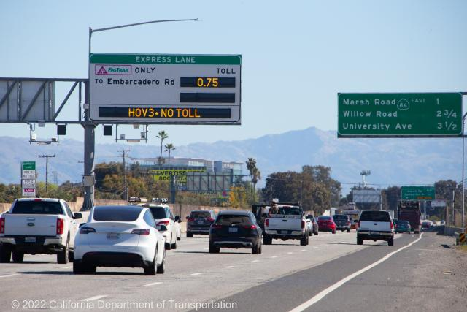
Key Takeaways
  Express Lanes are functioning as intended, delivering measurable improvements in corridor performance
  Despite known limitations, the study provides meaningful, actionable insights
  Regular monitoring is recommended
  Opportunities for Improvement
    Advanced occupancy-verification technologies to reduce reliance on self-reported transponder declarations
    Expand transit data integration to quantify express lane transit benefits
    Target persistent congestion hotspots with focused operational and enforcement strategies
Notes:
The express lanes are functioning as intended.
Benefits extend beyond express lane users to the broader corridor.
Known limitations are acknowledged and manageable.
Ongoing monitoring is essential to continued success.

Slide 21
Next Steps
Monitoring & Policy
Operations
Public Education
  Continue performance monitoring and update analyses as new data becomes available.
  Use findings to inform future corridor operations and policy decisions.
  Refine operations at key hot spots through dynamic pricing.
  Research occupancy verification.
  Explore improvements to adaptive ramp metering.
  Increase outreach on operating rules and safe merge practices.
Transit
Safety
  Partner with local transit operators to analyze Express Lane transit performance.
  Coordinate with CHP on targeted enforcement and data sharing.
  Review safety trends as additional post-project data becomes available and update report.
Notes:
Continue regular performance monitoring and reporting. - Commit to annual
Explore advanced occupancy verification technologies.
Expand transit data integration.
What are we committing to on safety?
Target remaining congestion hotspots with focused operational strategies.

Slide 22
Discussion
Notes:
We welcome Board questions, feedback, and direction.
This study is meant to inform future operational and policy decisions.
We see this as a living analysis that will evolve as the corridor matures.

